Slide 1



Memory Systems Fundamentals, Recent Research, Challenges, Opportunities Lecture 4: Low-Latency Memory
Prof. Onur Mutlu
omutlu@gmail.com
https://people.inf.ethz.ch/omutlu
9 October 2018
Technion Fast Course 2018

Slide 2
Four Key Directions
Fundamentally Secure/Reliable/Safe Architectures
Fundamentally Energy-Efficient Architectures
Memory-centric (Data-centric) Architectures
Fundamentally Low-Latency Architectures
Architectures for Genomics, Medicine, Health

Slide 3
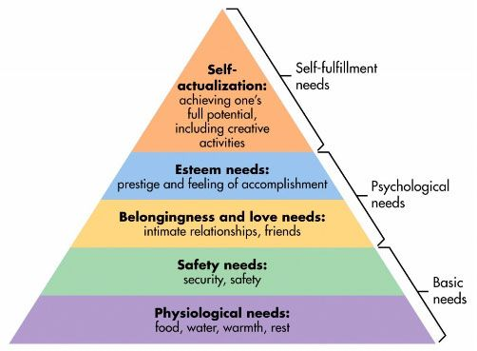
Maslow’s Hierarchy of Needs, A Third Time
Maslow, “A Theory of Human Motivation,”
Psychological Review, 1943.
Maslow, “Motivation and Personality,”
Book, 1954-1970.
Speed
Speed
Speed
Speed
Speed
Source: https://www.simplypsychology.org/maslow.html

Slide 4
Challenge and Opportunity for Future
Fundamentally
Low-Latency
Computing Architectures

Slide 5
Memory Latency: Fundamental Tradeoffs

Slide 6
Review: Memory Latency Lags Behind
128x
20x
1.3x
Memory latency remains almost constant

Slide 7




DRAM Latency Is Critical for Performance
In-memory Databases
[Mao+, EuroSys’12; Clapp+ (Intel), IISWC’15]
Graph/Tree Processing
[Xu+, IISWC’12; Umuroglu+, FPL’15]
In-Memory Data Analytics
[Clapp+ (Intel), IISWC’15;
Awan+, BDCloud’15]
Datacenter Workloads [Kanev+ (Google), ISCA’15]

Slide 8
DRAM Latency Is Critical for Performance
In-memory Databases
[Mao+, EuroSys’12; Clapp+ (Intel), IISWC’15]
Graph/Tree Processing
[Xu+, IISWC’12; Umuroglu+, FPL’15]
Long memory latency → performance bottleneck
In-Memory Data Analytics
[Clapp+ (Intel), IISWC’15;
Awan+, BDCloud’15]
Datacenter Workloads [Kanev+ (Google), ISCA’15]

Slide 9
The Memory Latency Problem
High memory latency is a significant limiter of system performance and energy-efficiency
It is becoming increasingly so with higher memory contention in multi-core and heterogeneous architectures
Exacerbating the bandwidth need
Exacerbating the QoS problem
It increases processor design complexity due to the mechanisms incorporated to tolerate memory latency

Slide 10
Retrospective: Conventional Latency Tolerance Techniques
Caching [initially by Wilkes, 1965]
Widely used, simple, effective, but inefficient, passive
Not all applications/phases exhibit temporal or spatial locality
Prefetching [initially in IBM 360/91, 1967]
Works well for regular memory access patterns
Prefetching irregular access patterns is difficult, inaccurate, and hardware-intensive
Multithreading [initially in CDC 6600, 1964]
Works well if there are multiple threads
Improving single thread performance using multithreading hardware is an ongoing research effort
Out-of-order execution [initially by Tomasulo, 1967]
Tolerates cache misses that cannot be prefetched
Requires extensive hardware resources for tolerating long latencies
None of These
Fundamentally Reduce
Memory Latency

Slide 11
Two Major Sources of Latency Inefficiency
Modern DRAM is not designed for low latency
Main focus is cost-per-bit (capacity)
Modern DRAM latency is determined by worst case conditions and worst case devices
Much of memory latency is unnecessary
Our Goal: Reduce Memory Latency at the Source of the Problem

Slide 12
What Causes the Long Memory Latency?

Slide 13
Why the Long Memory Latency?
Reason 1: Design of DRAM Micro-architecture
Goal: Maximize capacity/area, not minimize latency
Reason 2: “One size fits all” approach to latency specification
Same latency parameters for all temperatures
Same latency parameters for all DRAM chips (e.g., rows)
Same latency parameters for all parts of a DRAM chip
Same latency parameters for all supply voltage levels
Same latency parameters for all application data
…

Slide 14
Tiered Latency DRAM

Slide 15
What Causes the Long Latency?
DRAM Chip
DRAM Chip
cell array
subarray
Subarray
I/O
I/O
I/O
channel
channel
DRAM Latency = Subarray Latency + I/O Latency
DRAM Latency = Subarray Latency + I/O Latency
Dominant
Notes:
To understand what causes the long latency, let me take a look at the DRAM organization.
DRAM consists of two components, the cell array and the I/O circuitry. The cell array consists of multiple subarrays.
To read from a DRAM chip, the data is first accessed from the subarray and then the data is transferred over the channel by the I/O circuitry.
So, the DRAM latency is the sum of the subarray latency and the I/O latency.
We observed that the subarray latency is much higher than the I/O latency.
As a result, subarray is the dominant source of the DRAM latency as we explained in the paper.

Slide 16
Why is the Subarray So Slow?
Subarray
Cell
cell
wordline
bitline: 512 cells
access
row decoder
row decoder
transistor
capacitor
sense amplifier
bitline
sense amplifier
large sense amplifier
Long bitline
Amortizes sense amplifier cost → Small area
Large bitline capacitance → High latency & power
Notes:
The cell’s capacitor is small and can store only a small amount of charge.
That is why a subarray also has sense-amplifiers, which are specialized circuits that can detect the small amount of charge.
Unfortunately, a sense-amplifier size is about *100* times the cell size.
So, to amortize the area of the sense-amplifiers,
hundreds of cells share the same sense-amplifier through a long bitline.
However, a long bitline has a large capacitance that increases latency and power consumption.
Therefore, the long bitline is one of the dominant sources of high latency and high power consumption.
To understand why the subarray is so slow,
let me take a look at the subarray organization.

Slide 17
Trade-Off: Area (Die Size) vs. Latency
Long Bitline
Short Bitline
Faster
Smaller
Trade-Off: Area vs. Latency
Notes:
A naïve way to reduce the DRAM latency is to have short bitlines that have lower latency.
Unfortunately, short bitlines significantly increase the DRAM area.
Therefore, the bitline length exposes an important trade-off between area and latency.

Slide 18
Trade-Off: Area (Die Size) vs. Latency
32
Fancy DRAM
Short Bitline
Commodity DRAM
Long Bitline
64
Cheaper
128
256
512 cells/bitline
GOAL
Faster
Notes:
This figure shows the trade-off between DRAM area and latency as we change the bitline length.
Y-axis is the normalized DRAM area compared to a DRAM using 512 cells/bitline. A lower value is cheaper.
X-axis shows the latency in terms of tRC, an important DRAM timing constraint. A lower value is faster.
Commodity DRAM chips use long bitlines to minimize area cost. On the other hand, shorter bitlines achieve lower latency at higher cost.
Our goal is to achieve the best of both worlds: low latency and low area cost.

Slide 19
Approximating the Best of Both Worlds
Long Bitline
Long Bitline
Our Proposal
Short Bitline
Short Bitline
Small Area
Large Area
Small Area
High Latency
Low Latency
Low Latency
Need Isolation
Add Isolation Transistors
Short Bitline ➔ Fast
Notes:
To sum up, both long and short bitline do not achieve small area and low latency.
Long bitline has small area but has high latency while short bitline has low latency but has large area.
To achieve the best of both worlds, we first start from long bitline, which has small area.
After that, to achieve the low latency of short bitline, we divide the long bitline into two smaller segments.
The bitline length of the segment nearby the sense-amplifier is same as the length of short bitline.
Therefore, the latency of the segment is as low as the latency of the short bitline.
To isolate this fast segment from the other segment, we add isolation transistors that selectively connect the two segments.

Slide 20
Approximating the Best of Both Worlds
Long Bitline
Tiered-Latency DRAM
Our Proposal
Short Bitline
Long Bitline
Short Bitline
Small Area
Small Area
Large Area
High Latency
Low Latency
Low Latency
Small area using long bitline
Low Latency
Notes:
This way, our proposed approach achieves small area and low latency.
We call this new DRAM architecture as Tiered-Latency DRAM

Slide 21
Commodity DRAM vs. TL-DRAM [HPCA 2013]
DRAM Latency (tRC)
DRAM Power
+49%
+23%
(52.5ns)
Latency
Power
–56%
–51%
Near Far
Near Far
Commodity DRAM
Commodity DRAM
TL-DRAM
TL-DRAM
DRAM Area Overhead
~3%: mainly due to the isolation transistors
Notes:
This figure compares the latency.
Y-axis is normalized latency.
Compared to commodity DRAM, TL-DRAM’s near segment has 56% lower latency, while the far segment has 23% higher latency.
The right figure compares the power.
Y-axis is normalized power.
Compared to commodity DRAM, TL-DRAM’s near segment has 51% lower power consumption and the far segment has 49% higher power consumption.
Lastly, mainly due to the isolation transistor, Tiered-latency DRAM increases the die-size by about 3%.

Slide 22
Trade-Off: Area (Die-Area) vs. Latency
32
64
Cheaper
128
256
512 cells/bitline
Near Segment
Far Segment
GOAL
Faster
Notes:
Again, the figure shows the trade-off between area and latency in existing DRAM.
Unlike existing DRAM, TL-DRAM achieves low latency using the near segment while increasing the area by only 3%.
Although the far segment has higher latency than commodity DRAM, we show that efficient use of the near segment enables TL-DRAM to achieve high system performance.

Slide 23
Leveraging Tiered-Latency DRAM
TL-DRAM is a substrate that can be leveraged by the hardware and/or software
Many potential uses
Use near segment as hardware-managed inclusive cache to far segment
Use near segment as hardware-managed exclusive cache to far segment
Profile-based page mapping by operating system
Simply replace DRAM with TL-DRAM
Lee+, “Tiered-Latency DRAM: A Low Latency and Low Cost DRAM Architecture,” HPCA 2013.
Notes:
There are multiple ways to leverage the TL-DRAM substrate by hardware or software.
In this slide, I describe many such ways.
First, the near segment can be used as a hardware-managed inclusive cache to the far segment.
Second, the near segment can be used as a hardware-managed exclusive cache to the far segment.
Third, the operating system can intelligently allocate frequently-accessed pages to the near segment.
Forth mechanism is to simple replace DRAM with TL-DRAM without any near segment handling
While our paper provides detailed explanations and evaluations of first three mechanism,
in this talk, we will focus on the first approach, which is to use the near segment as a hardware managed cache for the far segment.

Slide 24
Near Segment as Hardware-Managed Cache
TL-DRAM
far segment
subarray
main
memory
near segment
cache
sense amplifier
I/O
channel
Challenge 1: How to efficiently migrate a row between segments?
Challenge 2: How to efficiently manage the cache?
Notes:
This diagram shows TL-DRAM organization.
Each subarray consists of the sense amplifier, near segment and far segment.
In this particular approach, only the far segment capacity is exposed to the operating system and the memory controller caches the frequently accessed rows in each subarray to the corresponding near segment.
This approach has two challenges.
First, how to migrate a row between segments efficiently?
Second, how to manage the near segment cache efficiently?
Let me first address first challenge.

Slide 25
Inter-Segment Migration
Goal: Migrate source row into destination row
Naïve way: Memory controller reads the source row byte by byte and writes to destination row byte by byte
→ High latency
Source
Far Segment
Isolation Transistor
Destination
Near Segment
Sense Amplifier
Notes:
Our goal is to migrate a source row in the far segment to a destination row in the near segment.
The naïve way to achieve this is that memory controller reads all the data from the source row and writes them back to the destination row.
However, this leads to high latency.

Slide 26
Inter-Segment Migration
Our way:
Source and destination cells share bitlines
Transfer data from source to destination across shared bitlines concurrently
Source
Far Segment
Isolation Transistor
Destination
Near Segment
Sense Amplifier
Notes:
Our observation is that cells in the source and the destination row share bitlines.
Our idea is to use these shared bitlines to transfer data from the source to the destination concurrently .
We’ll explain the migration procedure step by step.

Slide 27
Inter-Segment Migration
Our way:
Source and destination cells share bitlines
Transfer data from source to destination across shared bitlines concurrently
Step 1: Activate source row
Migration is overlapped with source row access
Additional ~4ns over row access latency
Far Segment
Step 2: Activate destination row to connect cell and bitline
Isolation Transistor
Near Segment
Sense Amplifier
Notes:
First, the memory controller accesses the source row in the far segment.
The isolation transistor is turned on and then the cells in the source row are connected to the bitlines.
After that, the sense amplifiers read the data of the source row.
Second, the memory controller accesses the destination row in the near segment.
Now, the cells in the destination row are also connected to the bitline.
Therefore, the data of sense amplifier are migrated to the destination row across the bitlines concurrently.
After these two steps, the all data of the source row are migrated to the destination row with low latency.
In fact, most of the migration latency is overlapped with the source row access latency.
Using SPICE simulation, we estimated that the additional migration latency over the row access latency is about 4ns.

Slide 28
Near Segment as Hardware-Managed Cache
TL-DRAM
far segment
subarray
main
memory
near segment
cache
sense amplifier
I/O
channel
Challenge 1: How to efficiently migrate a row between segments?
Challenge 2: How to efficiently manage the cache?
Notes:
Now, let me address the second challenge

Slide 29
Performance & Power Consumption
12.4%
11.5%
10.7%
–23%
–24%
–26%
Normalized Performance
Normalized Power
Core-Count (Channel)
Core-Count (Channel)
Using near segment as a cache improves performance and reduces power consumption
Lee+, “Tiered-Latency DRAM: A Low Latency and Low Cost DRAM Architecture,” HPCA 2013.
Notes:
This figure shows the IPC improvement of our three caching mechanisms over commodity DRAM.
All of them improve performance and benefit-based caching shows maximum performance improvement by 12.7%.
The right figure shows the normalized power reduction of our three caching mechanisms over commodity DRAM.
All of them reduce power consumption and benefit-based caching shows maximum power reduction by 23%.
Therefore, using near segment as a cache improves performance and reduces power consumption at the cost of 3% area overhead.

Slide 30
Single-Core: Varying Near Segment Length
Maximum IPC Improvement
Larger cache capacity
Performance Improvement
Higher cache access latency
Near Segment Length (cells)
By adjusting the near segment length, we can trade off cache capacity for cache latency
Notes:
This figure shows the performance improvement over commodity DRAM, when varying the near segment length.
X-axis is the near segment length and Y-axis is the IPC improvement over commodity DRAM.
Increasing the near segment length enables larger cache capacity but the trade-off is increasing the caching latency.
As a result, the peak performance improvement is at 32 cells/bitline.
We observe that by adjusting the near segment length, we can trade off cache capacity for cache latency.

Slide 31
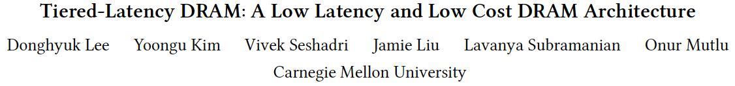
More on TL-DRAM
Donghyuk Lee, Yoongu Kim, Vivek Seshadri, Jamie Liu, Lavanya Subramanian, and Onur Mutlu, "Tiered-Latency DRAM: A Low Latency and Low Cost DRAM Architecture" Proceedings of the 19th International Symposium on High-Performance Computer Architecture (HPCA), Shenzhen, China, February 2013. Slides (pptx)

Slide 32
LISA: Low-Cost Inter-Linked Subarrays [HPCA 2016]

Slide 33
Problem: Inefficient Bulk Data Movement
Bulk data movement is a key operation in many applications
memmove & memcpy: 5% cycles in Google’s datacenter [Kanev+ ISCA’15]
Core
Core
LLC
Memory Controller
src
Channel
Core
Core
64 bits
dst
CPU
Memory
Long latency and high energy

Slide 34
Moving Data Inside DRAM?
8Kb
Bank
512 rows
Subarray 1
Bank
DRAM cell
Subarray 2
Bank
Subarray 3
…
…
Bank
Subarray N
DRAM
Internal Data Bus (64b)
Low connectivity in DRAM is the fundamental bottleneck for bulk data movement
Goal: Provide a new substrate to enable wide connectivity between subarrays

Slide 35
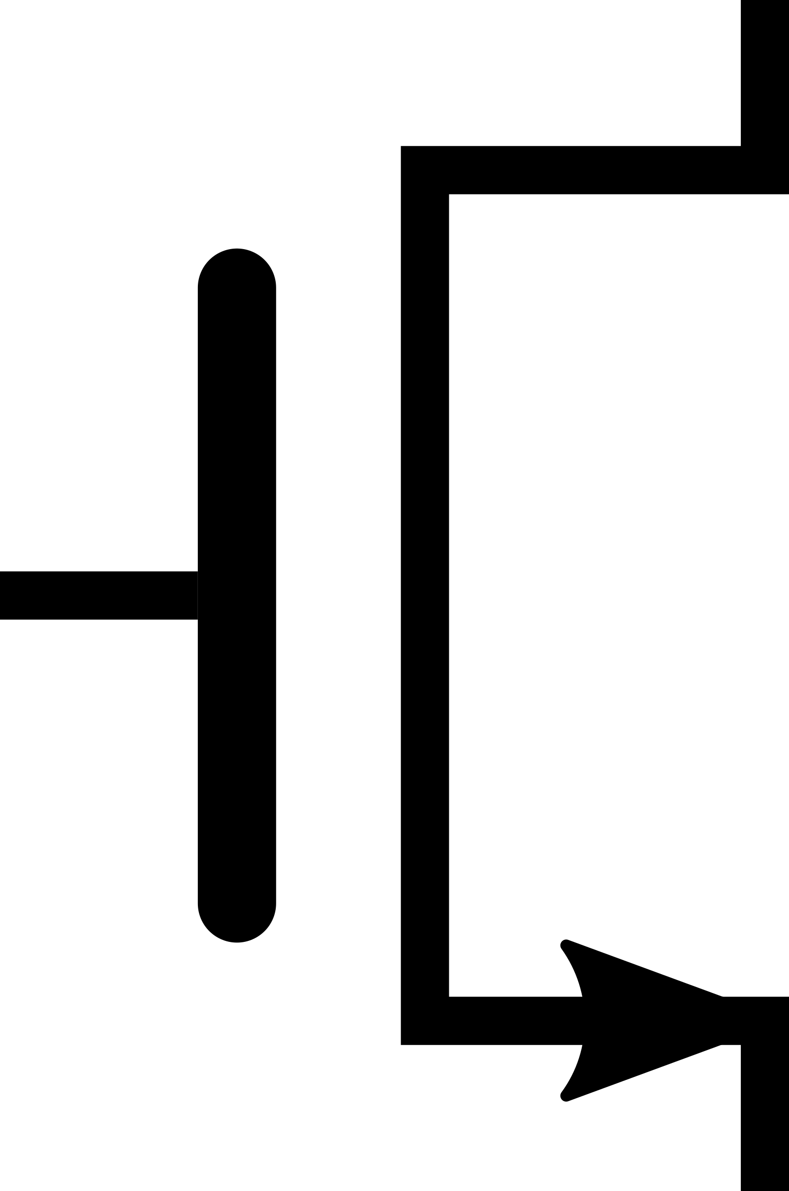
Key Idea and Applications
Low-cost Inter-linked subarrays (LISA)
Fast bulk data movement between subarrays
Wide datapath via isolation transistors: 0.8% DRAM chip area
LISA is a versatile substrate → new applications
Subarray 1
…
Subarray 2
Fast bulk data copy: Copy latency 1.363ms→0.148ms (9.2x) → 66% speedup, -55% DRAM energy
In-DRAM caching: Hot data access latency 48.7ns→21.5ns (2.2x) → 5% speedup
Fast precharge: Precharge latency 13.1ns→5.0ns (2.6x) → 8% speedup

Slide 36
New DRAM Command to Use LISA
Row Buffer Movement (RBM): Move a row of data in an activated row buffer to a precharged one
Subarray 1
V_{dd}-Δ
V_{dd}
V_{dd}
Activated
S
S
S
S
P
P
P
P
on
RBM: SA1→SA2
Charge
Sharing
Subarray 2
V_{dd}
V_{dd}/2
V_{dd}/2+Δ
RBM transfers an entire row b/w subarrays
Activated
Precharged
S
S
S
S
Amplify the charge
P
P
P
P
…

Slide 37
RBM Analysis
The range of RBM depends on the DRAM design
Multiple RBMs to move data across > 3 subarrays
Validated with SPICE using worst-case cells
NCSU FreePDK 45nm library
4KB data in 8ns (w/ 60% guardband) → 500 GB/s, 26x bandwidth of a DDR4-2400 channel
0.8% DRAM chip area overhead [O+ ISCA’14]
Subarray 1
Subarray 2
Subarray 3

Slide 38

1. Rapid Inter-Subarray Copying (RISC)
Goal: Efficiently copy a row across subarrays
Key idea: Use RBM to form a new command sequence
Subarray 1
1
src row
Activate src row
S
S
S
S
2
P
P
P
P
RBM SA1→SA2
Subarray 2
Reduces row-copy latency by 9.2x, DRAM energy by 48.1x
dst row
3
Activate dst row (write row buffer into dst row)
S
S
S
S
P
P
P
P

Slide 39
2. Variable Latency DRAM (VILLA)
Goal: Reduce DRAM latency with low area overhead
Motivation: Trade-off between area and latency
Long Bitline (DDRx)
Short Bitline (RLDRAM)
Shorter bitlines → faster activate and precharge time
High area overhead: >40%

Slide 40
2. Variable Latency DRAM (VILLA)
Key idea: Reduce access latency of hot data via a heterogeneous DRAM design [Lee+ HPCA’13, Son+ ISCA’13]
VILLA: Add fast subarrays as a cache in each bank
Slow Subarray
512 rows
Challenge: VILLA cache requires frequent movement of data rows
32 rows
Fast Subarray
LISA: Cache rows rapidly from slow to fast subarrays
Reduces hot data access latency by 2.2x at only 1.6% area overhead
Slow Subarray

Slide 41
3. Linked Precharge (LIP)
Problem: The precharge time is limited by the strength of one precharge unit
Linked Precharge (LIP): LISA precharges a subarray using multiple precharge units
S
S
S
S
S
S
S
S
on
P
P
P
P
P
P
P
P
Activated row
Reduces precharge latency by 2.6x
(43% guardband)
Precharging
Linked Precharging
S
S
S
S
on
S
S
S
S
on
P
P
P
P
P
P
P
P
Conventional DRAM
LISA DRAM

Slide 42
More on LISA
Kevin K. Chang, Prashant J. Nair, Saugata Ghose, Donghyuk Lee, Moinuddin K. Qureshi, and Onur Mutlu, "Low-Cost Inter-Linked Subarrays (LISA): Enabling Fast Inter-Subarray Data Movement in DRAM" Proceedings of the 22nd International Symposium on High-Performance Computer Architecture (HPCA), Barcelona, Spain, March 2016. [Slides (pptx) (pdf)] [Source Code]

Slide 43
Why the Long Memory Latency?
Reason 1: Design of DRAM Micro-architecture
Goal: Maximize capacity/area, not minimize latency
Reason 2: “One size fits all” approach to latency specification
Same latency parameters for all temperatures
Same latency parameters for all DRAM chips (e.g., rows)
Same latency parameters for all parts of a DRAM chip
Same latency parameters for all supply voltage levels
Same latency parameters for all application data
…

Slide 44
Tackling the Fixed Latency Mindset
Reliable operation latency is actually very heterogeneous
Across temperatures, chips, parts of a chip, voltage levels, …
Idea: Dynamically find out and use the lowest latency one can reliably access a memory location with
Adaptive-Latency DRAM [HPCA 2015]
Flexible-Latency DRAM [SIGMETRICS 2016]
Design-Induced Variation-Aware DRAM [SIGMETRICS 2017]
Voltron [SIGMETRICS 2017]
DRAM Latency PUF [HPCA 2018]
...
We would like to find sources of latency heterogeneity and exploit them to minimize latency

Slide 45

Latency Variation in Memory Chips
Heterogeneous manufacturing & operating conditions → latency variation in timing parameters
DRAM A
DRAM B
DRAM C
Slow cells
Low
High
DRAM Latency

Slide 46
Why is Latency High?
DRAM latency: Delay as specified in DRAM standards
Doesn’t reflect true DRAM device latency
Imperfect manufacturing process → latency variation
High standard latency chosen to increase yield
DRAM A
DRAM B
DRAM C
Standard
Latency
Manufacturing Variation
Low
High
DRAM Latency
Notes:
To understand the latency problem, we need to go into what defines latency.
DRAM latency is the total amnt of time that the underlying hw operations need <> to retrieve data.
The DRAM standards define a single fixed time for how long these ops should take in every DRAM chip.
However, this defined delay doesn’t actually reflect the latency of the individual DRAMs.
<Timeline illustration>
Because the manufacturing process is imperfect, it introduces variation in the production chips, resulting in latency variation across different chips.
This simple illustartion shows the difference b/w the average latency across 3 different dram chips, to convey the point of latency variation.
It’s important to note that not only does latency variation exists <across> chips, but also <inside> each dram chip itself.
<Blue standard>
Since we don’t want to throw away the chips with high variation, we tolerate them.
The simple way is to <slow> down the acceptable latency so that the majority of chips can all work reliably under this high standard latency.
as we can see, the high standard latency is a result of a trade-off made for higher DRAM production yield.
---
<> Operative word

Slide 47
What Causes the Long Memory Latency?
Conservative timing margins!
DRAM timing parameters are set to cover the worst case
Worst-case temperatures
85 degrees vs. common-case
to enable a wide range of operating conditions
Worst-case devices
DRAM cell with smallest charge across any acceptable device
to tolerate process variation at acceptable yield
This leads to large timing margins for the common case

Slide 48
Understanding and Exploiting Variation in DRAM Latency

Slide 49
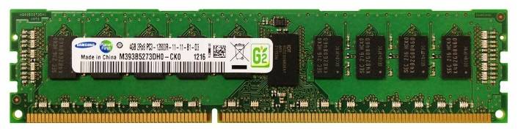
DRAM Stores Data as Charge
DRAM Cell
Three steps of charge movement
1. Sensing
2. Restore
3. Precharge
Sense-Amplifier
Notes:
The right figure shows DRAM organization which is consists of DRAM cells and sense-amplifiers.
There are three steps for accessing DRAM.
First, when DRAM selects one of rows in its cell array, the selected cells drive their charge to sense-amplifiers.
Then, sense-amplifiers detect the charge, recognizing data of cells.
We call this operation as sensing.
Second, after sensing data from DRAM cells, sense-amplifiers drive charge to the cells for reconstructing original data.
We call this operation as restore.
Third, after restoring the cell data, DRAM deselects the accessed row and puts the sense-amplifiers to original state for next access.
We call this operation as precharge.
As shown in these three steps, DRAM operation is charge movement between cell and sense-amplifier.

Slide 50
DRAM Charge over Time
Cell
Cell
Data 1
charge
Sense-Amplifier
Sense-Amplifier
Data 0
Timing Parameters
Sensing
Restore
time
In theory
margin
In practice
Why does DRAM need the extra timing margin?
Notes:
Timing parameters exist to ensure sufficient movement of charge.
The figure shows the timeline for accessing DRAM in X-axis and Y-axis shows the charge amount in DRAM cell and sense-amplifier.
When selecting a row of cells, each cell drives their charge toward to the corresponding sense-amplifier.
If driven charge is more than enough to detect the data, the sense-amplifier starts to restore data by driving charge toward the cell.
This restore operation finishes when the cell is fully charged.
Ideally, DRAM timing parameters are just enough for the sufficient movement of charge.
However, in practice, there are large margin in DRAM timing parameters.
Why are these margin required?

Slide 51
Two Reasons for Timing Margin
1. Process Variation
DRAM cells are not equal
Leads to extra timing margin for cell that can store small amount of charge
`
1. Process Variation
DRAM cells are not equal
Leads to extra timing margin for a cell that can store a large amount of charge
1. Process Variation
DRAM cells are not equal
Leads to extra timing margin for a cell that can store a large amount of charge
2. Temperature Dependence
DRAM leaks more charge at higher temperature
Leads to extra timing margin when operating at low temperature
Notes:
There are two reasons for the margin in DRAM timing parameters.
First is process variation and second is temperature dependence.
Let me introduce the first factor, process variation.

Slide 52
DRAM Cells are Not Equal
Ideal
Real
Smallest Cell
Largest Cell
Same Size ➔
Different Size ➔
Large variation in cell size ➔
Same Charge ➔
Different Charge ➔
Large variation in charge ➔
Same Latency
Different Latency
Large variation in access latency
Notes:
Ideally, DRAM would have uniform cells which have same size, thereby having same access latency.
Unfortunately, due to process variation, each cell has different size, thereby having different access latency.
Therefore, DRAM shows large variation in both charge amount in its cell and access latency to its cell.

Slide 53
Process Variation
DRAM Cell
❶ Cell Capacitance
❷ Contact Resistance
Capacitor
❸ Transistor Performance
Small cell can store small charge
Bitline
Contact
Small cell capacitance
High contact resistance
Slow access transistor
Access Transistor
ACCESS
➔ High access latency
Notes:
Ideally, DRAM would have uniform cells which have same size, thereby having same access latency.
Unfortunately, due to process variation, each cell has different size, thereby having different access latency.
Therefore, DRAM shows large variation in both charge amount in its cell and access latency to its cell.

Slide 54
Two Reasons for Timing Margin
1. Process Variation
DRAM cells are not equal
Leads to extra timing margin for a cell that can store a large amount of charge
`
2. Temperature Dependence
DRAM leaks more charge at higher temperature
Leads to extra timing margin for cells that operate at low temperature
2. Temperature Dependence
DRAM leaks more charge at higher temperature
Leads to extra timing margin for cells that operate at the high temperature
2. Temperature Dependence
DRAM leaks more charge at higher temperature
Leads to extra timing margin for cells that operate at the high temperature
Notes:
Let me introduce the second factor temperature dependence.

Slide 55

Charge Leakage Temperature
Room Temp.
Hot Temp. (85°C)
Cells store small charge at high temperature
and large charge at low temperature
→ Large variation in access latency
Small Leakage
Large Leakage
Notes:
DRAM leakage increases the variation.
DRAM loses their charge over time and loses more charge at higher temperature.
Therefore, DRAM cell has smallest charge when operating at hot temperature, for example 85C which is the highest temperature guaranteed by DRAM standard.
This temperature dependence increases the variation in DRAM cell charge.

Slide 56
DRAM Timing Parameters
DRAM timing parameters are dictated by the worst-case
The smallest cell with the smallest charge in all DRAM products
Operating at the highest temperature
Large timing margin for the common-case

Slide 57
Adaptive-Latency DRAM [HPCA 2015]
Idea: Optimize DRAM timing for the common case
Current temperature
Current DRAM module
Why would this reduce latency?
A DRAM cell can store much more charge in the common case (low temperature, strong cell) than in the worst case
More charge in a DRAM cell
→ Faster sensing, charge restoration, precharging
→ Faster access (read, write, refresh, …)
Lee+, “Adaptive-Latency DRAM: Optimizing DRAM Timing for the Common-Case,” HPCA 2015.

Slide 58
Extra Charge → Reduced Latency
1. Sensing
Sense cells with extra charge faster
→ Lower sensing latency
2. Restore
No need to fully restore cells with extra charge
→ Lower restoration latency
3. Precharge
No need to fully precharge bitlines for cells with extra charge
→ Lower precharge latency
Notes:
Remember there are three steps in DRAM operation, sensing, restore, and precharge.
In all these steps, the excessive charge enables potential timing parameter reduction.
Let me introduce these three scenarios in order.

Slide 59
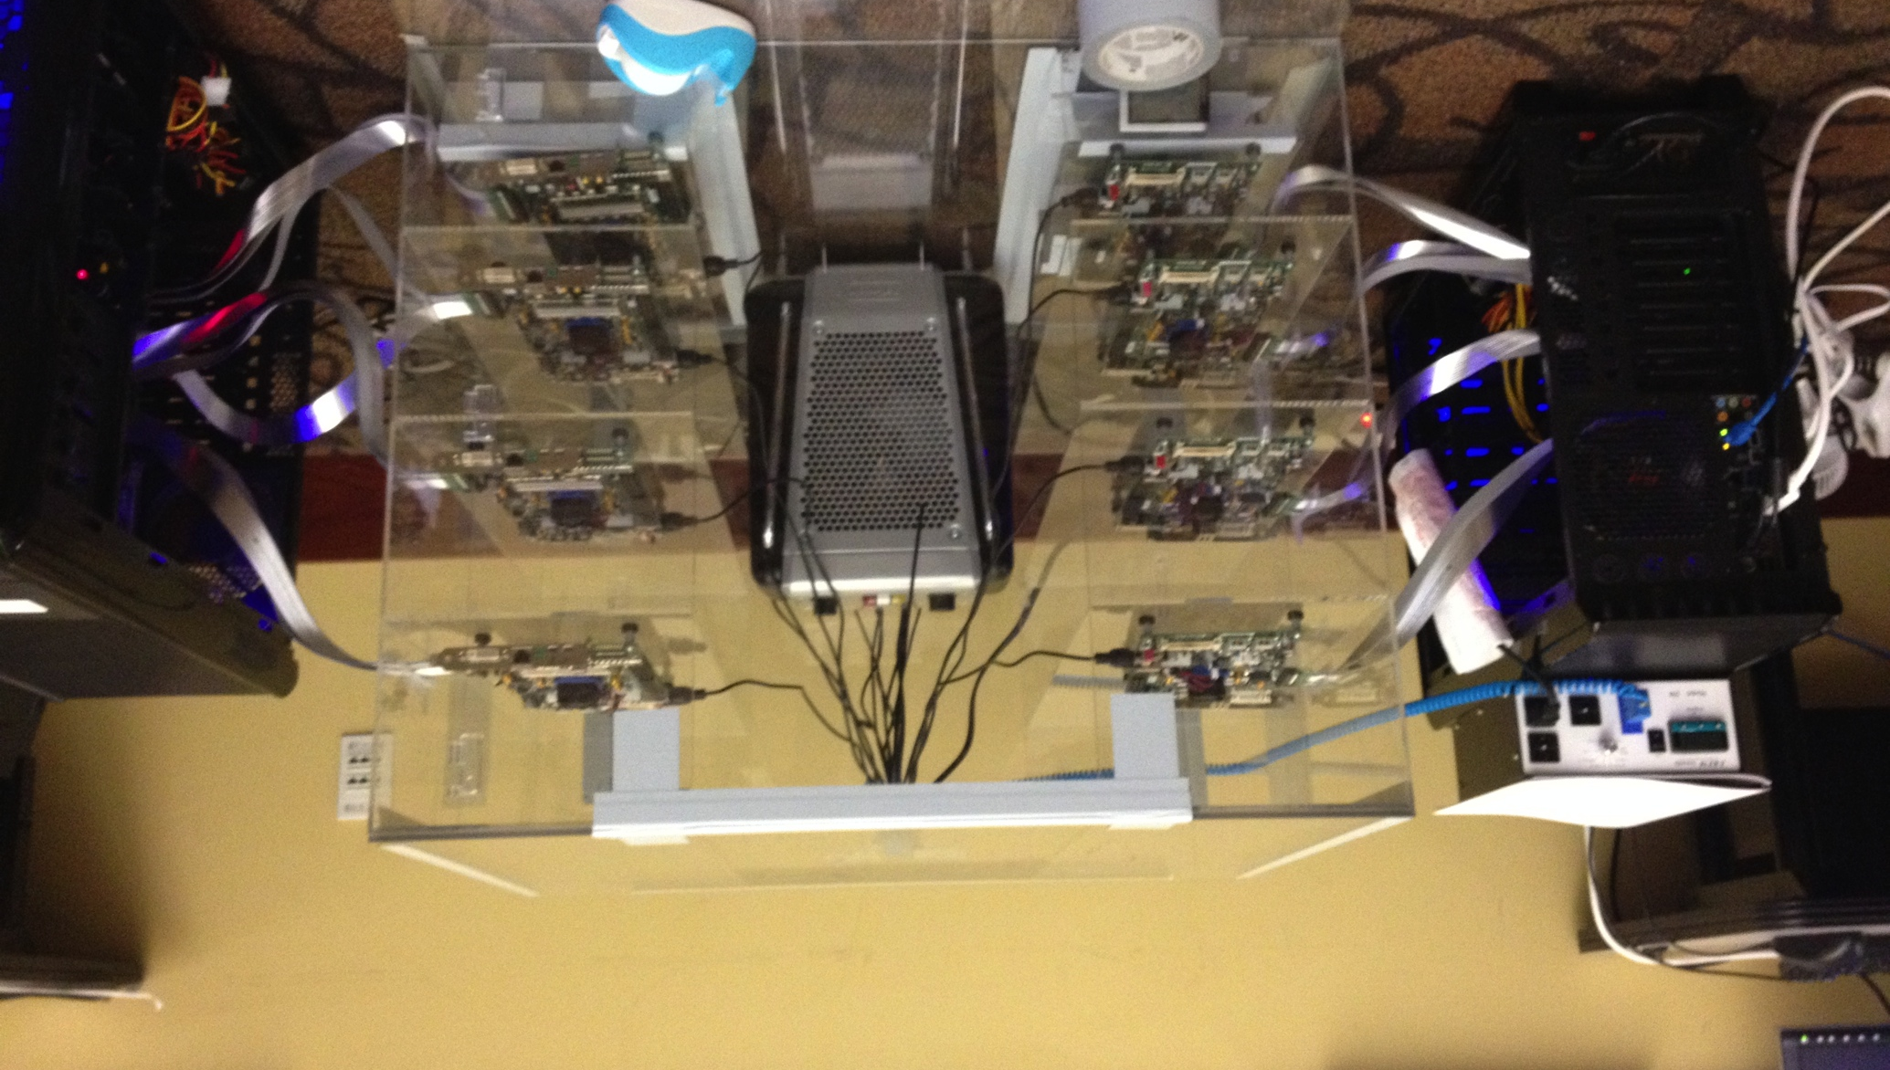
DRAM Characterization Infrastructure
Temperature
Controller
FPGAs
Heater
FPGAs
PC
Kim+, “Flipping Bits in Memory Without Accessing Them: An Experimental Study of DRAM Disturbance Errors,” ISCA 2014.

Slide 60
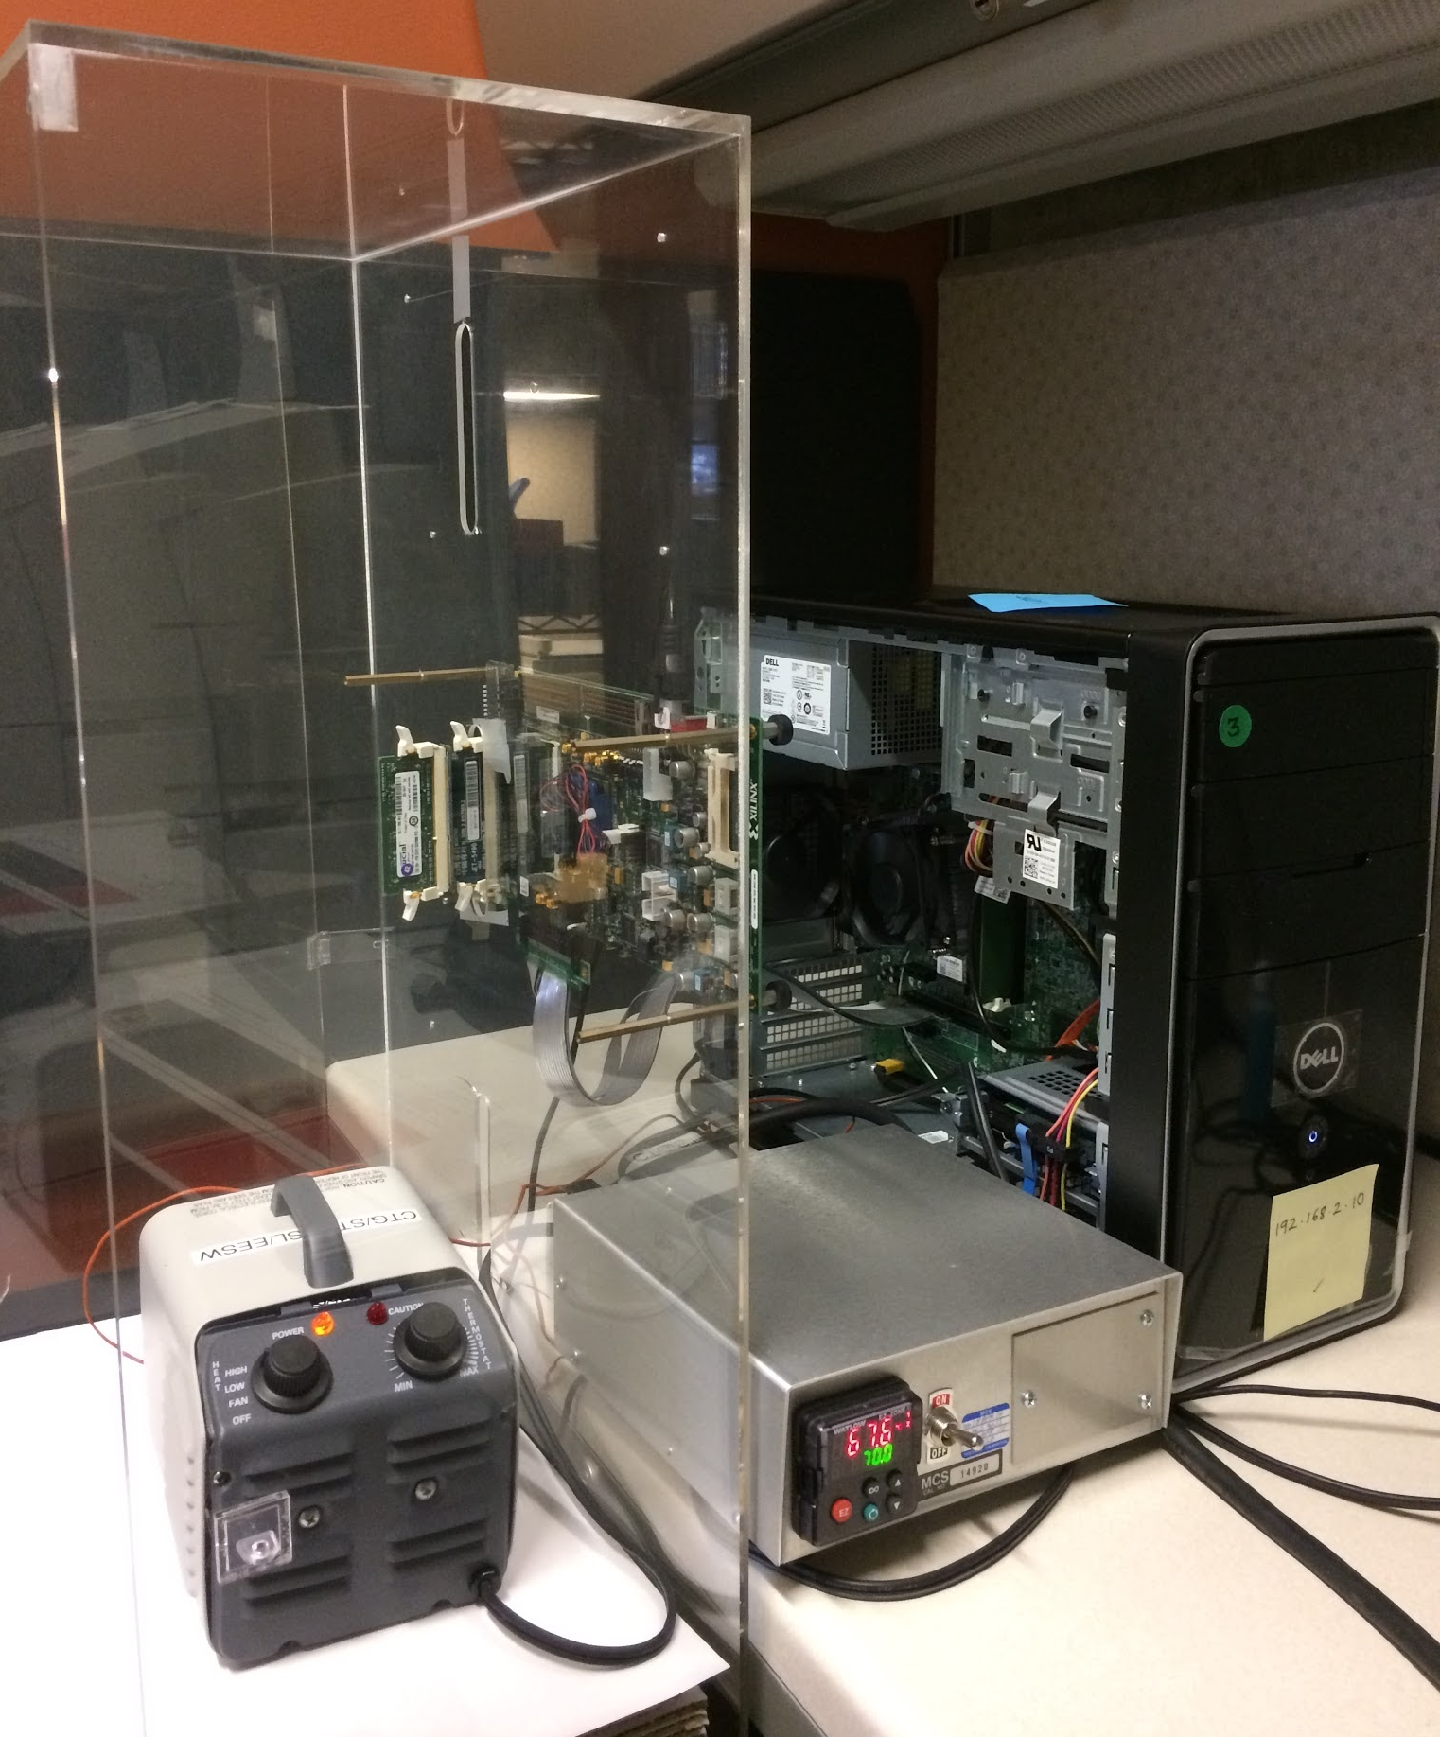
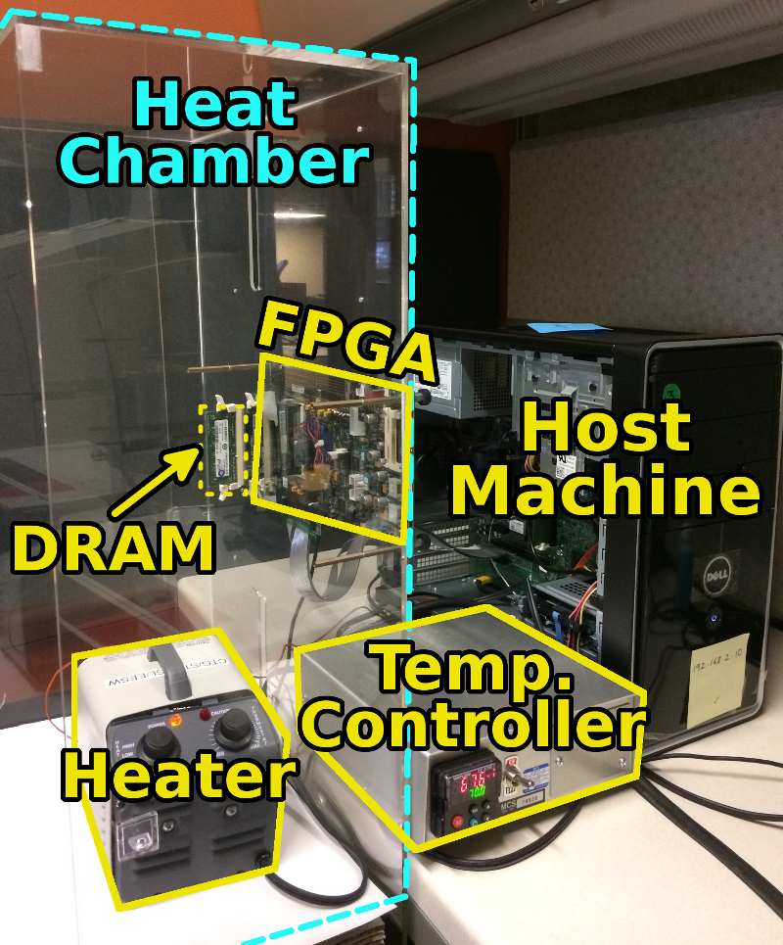
DRAM Characterization Infrastructure
Hasan Hassan et al., SoftMC: A Flexible and Practical Open-Source Infrastructure for Enabling Experimental DRAM Studies, HPCA 2017.
Flexible
Easy to Use (C++ API)
Open-source
github.com/CMU-SAFARI/SoftMC

Slide 61
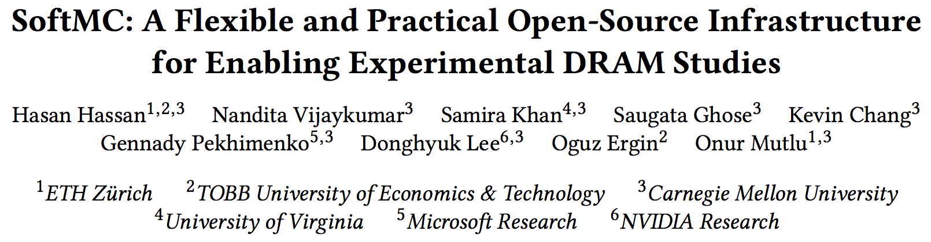
SoftMC: Open Source DRAM Infrastructure
https://github.com/CMU-SAFARI/SoftMC

Slide 62
Observation 1. Faster Sensing
115 DIMM
Characterization
Typical DIMM at
Low Temperature
Timing
(tRCD)
17% ↓
No Errors
More Charge
Strong Charge
Flow
Faster Sensing
Typical DIMM at Low Temperature
➔ More charge ➔ Faster sensing
Notes:
First step in DRAM operation is sensing.
In typical case, there are more charge in DRAM cell compared to the worst case.
The excessive charge enables stronger charge drive to sense-amplifier.
Then, sense-amplifier can detect data of DRAM cell fast, thereby complete sensing operation fast.
In our DRAM latency profiling results of 115 DRAM modules,
we observe that 17% potential reduction for the corresponding timing parameters of sensing.
As a result, more charge in typical cases lead to fast sensing.

Slide 63
Observation 2. Reducing Restore Time
115 DIMM
Characterization
Typical DIMM at
Low Temperature
Read (tRAS)
37% ↓
Write (tWR)
54% ↓
No Errors
Less Leakage ➔
Extra Charge
No Need to Fully
Restore Charge
Typical DIMM at lower temperature
➔ More charge ➔ Restore time reduction
Notes:
Second step in DRAM operation is restore.
Due to larger size and less leakage, typical DRAM cells have more charge than the worst cell.
Even though typical DRAM does not restore the excessive charge during restore operation,
eventually the typical cell has more charge than the worst case cell, guaranteeing reliable operations.
By reducing this restore time in DRAM read/write, our DRAM latency characterization shows significant potential to reduce corresponding timing parameters. For example, 37% for read and 54% for write.
As a result, more charge in typical cases enables restore time reduction.

Slide 64
AL-DRAM
Key idea
Optimize DRAM timing parameters online
Two components
DRAM manufacturer provides multiple sets of reliable DRAM timing parameters at different temperatures for each DIMM
System monitors DRAM temperature & uses appropriate DRAM timing parameters
reliable DRAM timing parameters
DRAM temperature
Lee+, “Adaptive-Latency DRAM: Optimizing DRAM Timing for the Common-Case,” HPCA 2015.

Slide 65
DRAM Temperature
DRAM temperature measurement
Server cluster: Operates at under 34°C
Desktop: Operates at under 50°C
DRAM standard optimized for 85°C
DRAM operates at low temperatures in the common-case
Previous works – DRAM temperature is low
El-Sayed+ SIGMETRICS 2012
Liu+ ISCA 2007
Previous works – Maintain low DRAM temperature
David+ ICAC 2011
Liu+ ISCA 2007
Zhu+ ITHERM 2008

Slide 66
Latency Reduction Summary of 115 DIMMs
Latency reduction for read & write (55°C)
Read Latency: 32.7%
Write Latency: 55.1%
Latency reduction for each timing parameter (55°C)
Sensing: 17.3%
Restore: 37.3% (read), 54.8% (write)
Precharge: 35.2%
Lee+, “Adaptive-Latency DRAM: Optimizing DRAM Timing for the Common-Case,” HPCA 2015.

Slide 67
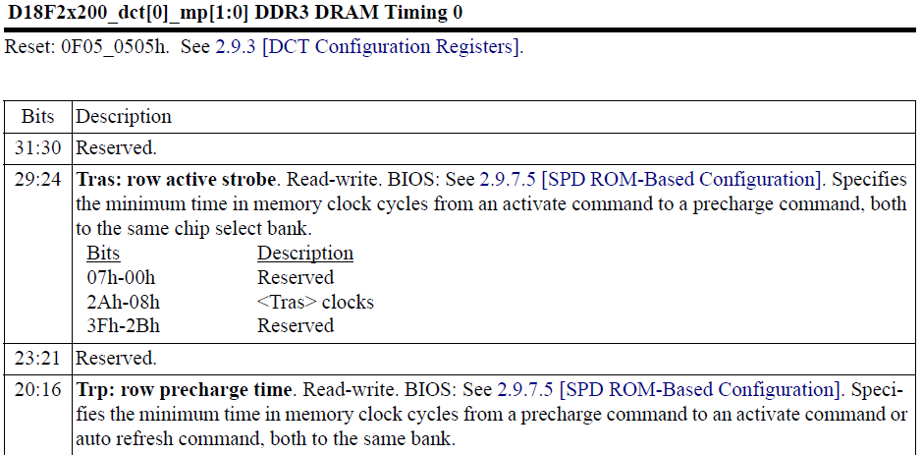
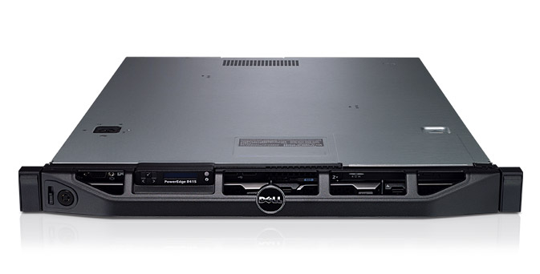
AL-DRAM: Real System Evaluation
System
CPU: AMD 4386 ( 8 Cores, 3.1GHz, 8MB LLC)
DRAM: 4GByte DDR3-1600 (800Mhz Clock)
OS: Linux
Storage: 128GByte SSD
Workload
35 applications from SPEC, STREAM, Parsec, Memcached, Apache, GUPS

Slide 68
AL-DRAM: Single-Core Evaluation
Average
Improvement
6.7%
Performance Improvement
5.0%
1.4%
all-35-workload
AL-DRAM improves performance on a real system

Slide 69
AL-DRAM: Multi-Core Evaluation
Average
Improvement
14.0%
10.4%
Performance Improvement
2.9%
all-35-workload
AL-DRAM provides higher performance for
multi-programmed & multi-threaded workloads

Slide 70
Reducing Latency Also Reduces Energy
AL-DRAM reduces DRAM power consumption by 5.8%
Major reason: reduction in row activation time

Slide 71
AL-DRAM: Advantages & Disadvantages
Advantages
+ Simple mechanism to reduce latency
+ Significant system performance and energy benefits
+ Benefits higher at low temperature
+ Low cost, low complexity
Disadvantages
- Need to determine reliable operating latencies for different temperatures and different DIMMs → higher testing cost
(might not be that difficult for low temperatures)

Slide 72
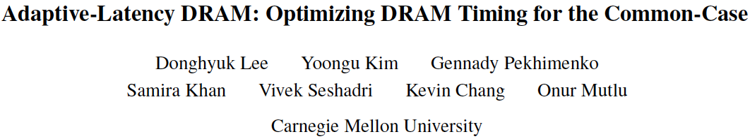
More on AL-DRAM
Donghyuk Lee, Yoongu Kim, Gennady Pekhimenko, Samira Khan, Vivek Seshadri, Kevin Chang, and Onur Mutlu, "Adaptive-Latency DRAM: Optimizing DRAM Timing for the Common-Case" Proceedings of the 21st International Symposium on High-Performance Computer Architecture (HPCA), Bay Area, CA, February 2015. [Slides (pptx) (pdf)] [Full data sets]

Slide 73
Different Types of Latency Variation
AL-DRAM exploits latency variation
Across time (different temperatures)
Across chips
Is there also latency variation within a chip?
Across different parts of a chip

Slide 74
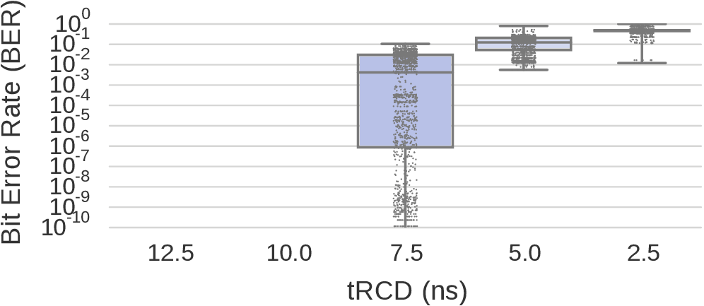
Variation in Activation Errors
Results from 7500 rounds over 240 chips
No ACT Errors
Max
Many errors
Rife w/ errors
Quartiles
Very few errors
Min
13.1ns
standard
Modern DRAM chips exhibit significant variation in activation latency
Different characteristics across DIMMs
Notes:
I’ll show you the distribution of activation errors collected from 7500 rds of tests.
In this figure, I’m showing the bit error rate in the y axis which is the fraction of timing errors in the total population of tested bits or
in other words the fraction of slow cells that cannot be read under the specified trcd. So lower is better. x-axis is the tested act late.
Here are several observations.
First, we observe no act errors on any DIMM when we reduce trcd from 13.1ns to 12.5 and 10ns. Since yaxis is in log scale, no data pt can be displayed here for 0 ber.
This shows the guardband added to protect against variation.
Second, reducing latency from 10 to 7.5ns starts to induce errors.
Here I’m showing you boxplots with quartiles and the whiskers indicate the min and max.
In addition, I’m overlaying all the observation points where each point is a single experiment conducted on a whole dim.
We can see that at t=7.5ns, BER varies significantly, but it doesn’t reach to 100% for all the chips, showing that not all cells fail together.
A breakdown analysis shows that the BER heavily depends on the DRAM models and vendors.
There are certain DIMMs that observe very few bit flips out of billions of cells and there are others that observe a lot more errors.
As the latency reduces furtherdown to 2.5ns, most dimms become rife with errors
That main takeaway is that modern ..
*** Now we see the variation of activation errors across different dimms, now let’s take a look at activation errors spreading across within a DIMM.

Slide 75
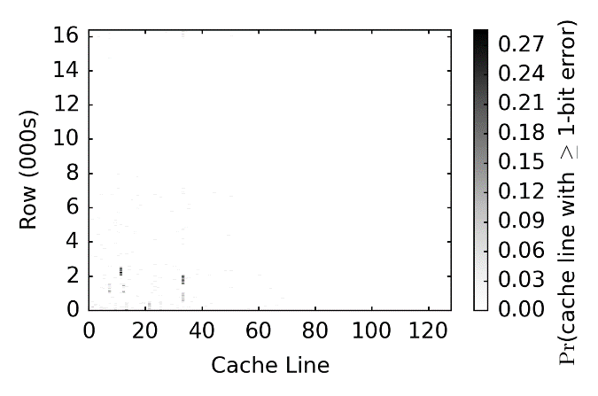
Spatial Locality of Activation Errors
One DIMM @ tRCD=7.5ns
Activation errors are concentrated at certain columns of cells
Notes:
This fig is showing the prob. of seeing at least 1 bit error in each cache line from one DIMM under trcd = 7.5ns. The y-axis is the row # (in 000s) and the x-axis is the cl #.
The main observation is that errors exhibit spatial locality. In this DIMM, errors tend to cluster at certain columns of cache lines without errors in the majority of the remaining cl.
This is an imperative observation for our proposed mechanism, which I’ll discuss later.
Next, we investigate the impact of reading different data patterns stored in these cells.

Slide 76
Mechanism to Reduce DRAM Latency
Observation: DRAM timing errors (slow DRAM cells) are concentrated on certain regions
Flexible-LatencY (FLY) DRAM
A software-transparent design that reduces latency
Key idea:
1) Divide memory into regions of different latencies
2) Memory controller: Use lower latency for regions without slow cells; higher latency for other regions
Chang+, “Understanding Latency Variation in Modern DRAM Chips: Experimental
Characterization, Analysis, and Optimization",” SIGMETRICS 2016.
Notes:
To summarize the observations so far, we find that dram timing errors due to shortened act and pre don’t occur in all cells and they are concentrated at certain regions.
So let’s go back to our second main goal which is on improving latency.
TO achieve this, we propose a software… design, called flex.. Dram or FLY for short, to reduce dram latency.
The key idea is the following:
We divide the dram up into different regions based on a latency variation profile.
Then We enable the mc to use different latency for diff regions.
For regions without slow cells, we are going to run it faster at a much lower latency.
For any region that has slow cells, we are going to operate at a higher latency.

Slide 77
FLY-DRAM Configurations
tRCD
99%
93%
12%
Profiles of 3 real DIMMs
tRP
99%
74%
13%
Chang+, “Understanding Latency Variation in Modern DRAM Chips: Experimental
Characterization, Analysis, and Optimization",” SIGMETRICS 2016.
Notes:
We evaluate FLY-DRAM with various configurations.
These 2 figures show the fraction of cells with different latencies for act and pre.
X-axis shows you the configurations that we have.
First, we evaluate a baseline dram system with the standardized latency at 13ns.
Then we use latency profiles that were collected from 3 real DIMMs. The percentage numbers show you the fraction of fast cells in each DIMM.
Note that Darker color means faster latency.
We also evalaute an upperbound configuration that has 100% fast cells under 7.5ns.

Slide 78
Results
19.7%
19.5%
17.6%
13.3%
FLY-DRAM improves performance by exploiting spatial latency variation in DRAM
Chang+, “Understanding Latency Variation in Modern DRAM Chips: Experimental
Characterization, Analysis, and Optimization",” SIGMETRICS 2016.
Notes:
This figure illustrates the average sys perf improvement of FLY with the three real DIMMs profiles over 40 workloads compared to the baseline
D1 has the least amount of fast cells and D3 has the most.
FLY-DRAM improves performance by 13, 17, and 19% for the 3 real dimms. And it has an upperbound perf at 19.7%.
We see that Fly’s improvement correlate with the fraction of fast cells.
The results show that using FLY-DRAM improves performance by …

Slide 79
FLY-DRAM: Advantages & Disadvantages
Advantages
+ Reduces latency significantly
+ Exploits significant within-chip latency variation
Disadvantages
- Need to determine reliable operating latencies for different parts of a chip → higher testing cost
- Slightly more complicated controller

Slide 80
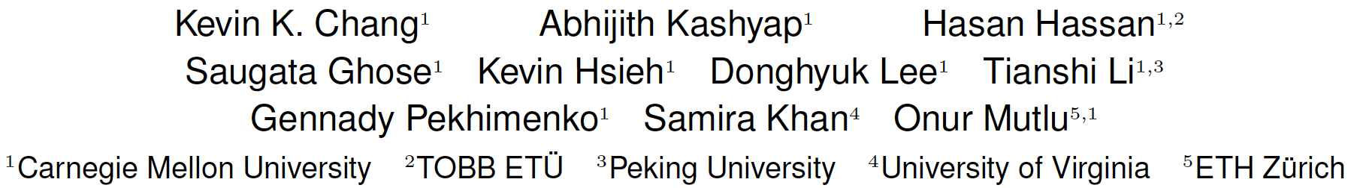
Analysis of Latency Variation in DRAM Chips
Kevin Chang, Abhijith Kashyap, Hasan Hassan, Samira Khan, Kevin Hsieh, Donghyuk Lee, Saugata Ghose, Gennady Pekhimenko, Tianshi Li, and Onur Mutlu, "Understanding Latency Variation in Modern DRAM Chips: Experimental Characterization, Analysis, and Optimization" Proceedings of the ACM International Conference on Measurement and Modeling of Computer Systems (SIGMETRICS), Antibes Juan-Les-Pins, France, June 2016. [Slides (pptx) (pdf)] [Source Code]

Slide 81
Spatial Distribution of Failures
How are activation failures spatially distributed in DRAM?
1024
DRAM Row (number)
Subarray Edge
512
0
512
1024
DRAM Column (number)
Activation failures are highly constrained
to local bitlines

Slide 82
Short-term Variation
Does a bitline’s probability of failure change over time?
A weak bitline is likely to remain weak and
a strong bitline is likely to remain strong over time

Slide 83
Short-term Variation
Does a bitline’s probability of failure change over time?
This shows that we can rely on a static profile of weak bitlines to determine whether an access will cause failures
We can rely on a static profile of weak bitlines
to determine whether an access will cause failures
A weak bitline is likely to remain weak and
a strong bitline is likely to remain strong over time

Slide 84
Write Operations
How are write operations affected by reduced t_{RCD}?
Weak bitline
Cache line
…
✔
✔
Row Decoder
…
…
…
…
…
Local Row Buffer
Local Row Buffer
✔
✔
WRITE
We can reliably issue write operations
with significantly reduced t_{RCD} (e.g., by 77%)

Slide 85
Solar-DRAM
Uses a static profile of weak subarray columns
Identifies subarray columns as weak or strong
Obtained in a one-time profiling step
Three Components
Variable-latency cache lines (VLC)
Reordered subarray columns (RSC)
Reduced latency for writes (RLW)

Slide 86
Solar-DRAM
Uses a static profile of weak subarray columns
Identifies subarray columns as weak or strong
Obtained in a one-time profiling step
Three Components
Variable-latency cache lines (VLC)
Reordered subarray columns (RSC)
Reduced latency for writes (RLW)

Slide 87
Solar-DRAM: VLC (I)
Weak bitline
Strong bitline
Cache line
…
Row Decoder
…
…
…
…
Local Row Buffer
Identify cache lines comprised of strong bitlines
Access such cache lines with a reduced t_{RCD}

Slide 88
Solar-DRAM
Uses a static profile of weak subarray columns
Identifies subarray columns as weak or strong
Obtained in a one-time profiling step
Three Components
Variable-latency cache lines (VLC)
Reordered subarray columns (RSC)
Reduced latency for writes (RLW)

Slide 89
Solar-DRAM: RSC (II)
Cache line 1
Cache line 0
Cache line 1
Cache line 0
Cache line
…
Row Decoder
…
…
…
…
Local Row Buffer
Remap cache lines across DRAM at the memory controller level so cache line 0 will likely map to a strong cache line

Slide 90
Solar-DRAM
Uses a static profile of weak subarray columns
Identifies subarray columns as weak or strong
Obtained in a one-time profiling step
Three Components
Variable-latency cache lines (VLC)
Reordered subarray columns (RSC)
Reduced latency for writes (RLW)

Slide 91
Solar-DRAM: RLW (III)
All bitlines are strong when issuing writes
Cache line
…
Row Decoder
…
…
…
…
Local Row Buffer
Write to all locations in DRAM with a significantly reduced t_{RCD} (e.g., by 77%)

Slide 92
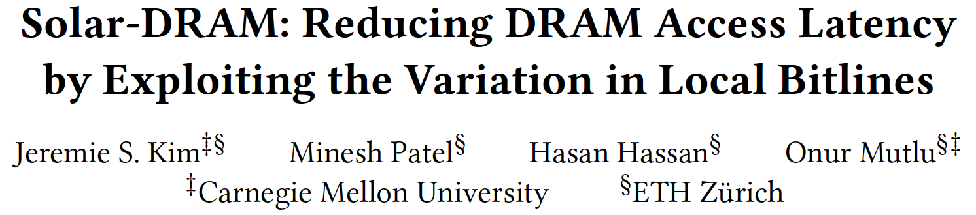
More on Solar-DRAM
Jeremie S. Kim, Minesh Patel, Hasan Hassan, and Onur Mutlu, "Solar-DRAM: Reducing DRAM Access Latency by Exploiting the Variation in Local Bitlines" Proceedings of the 36th IEEE International Conference on Computer Design (ICCD), Orlando, FL, USA, October 2018.

Slide 93
Why Is There Spatial Latency Variation Within a Chip?

Slide 94
What Is Design-Induced Variation?
fast
slow
across column
inherently slow
distance from wordline driver
slow
across row
wordline drivers
distance from sense amplifier
fast
Inherently fast
sense amplifiers
Systematic variation in cell access times
caused by the physical organization of DRAM
Notes:
As we described, cells in a mat have different distances from peripheral logic.
Cells in different rows have different distance from the sense amplifiers.
Cells in different columns have different distance from the wordline drivers.
Therefore, some regions are inherently faster than other regions,
and some regions are inherently slower than other regions.
We call this architectural variation.

Slide 95
DIVA Online Profiling
Design-Induced-Variation-Aware
inherently slow
wordline driver
sense amplifier
Profile only slow regions to determine min. latency
→ Dynamic & low cost latency optimization
Notes:
We propoe AVA Online profiling.
The key idea is profiling only slow regions to determine latency, leading to low cost online DRAM test.

Slide 96
DIVA Online Profiling
Design-Induced-Variation-Aware
slow cells
inherently slow
process
variation
design-induced
variation
wordline driver
random error
localized error
error-correcting code
online profiling
sense amplifier
Combine error-correcting codes & online profiling
→ Reliably reduce DRAM latency
Notes:
However, due to the process variation, some cells are more vulnerable than other cells, as the figure show.
These cells are randomly distributed while cells in the slow regions cause localized error.
To address both type of cells,
We integrate conventional ECC to correct the process variation induced errors.
Therefore, combining ECC and online profiling leads to reliably reducing DRAM latency.

Slide 97
DIVA-DRAM Reduces Latency
Read
Write
Latency Reduction
DIVA
DIVA
DIVA
DIVA
DIVA-DRAM reduces latency more aggressively and uses ECC to correct random slow cells
Notes:
The figure compares latency reduction by using AL-DRAM, AVA Profiling, and both AVA Profiling and Shuffling.
As we can, using AVA profiling and shuffling enables more latency reduction compared to AL-DRAM.
This is mainly because ECC corrects the worst cells in a DRAM module, reducing more latency.
Therefore, we conclude that AVA-DRAM reduces latency significantly.

Slide 98
DIVA-DRAM: Advantages & Disadvantages
Advantages
++ Automatically finds the lowest reliable operating latency at system runtime (lower production-time testing cost)
+ Reduces latency more than prior methods (w/ ECC)
+ Reduces latency at high temperatures as well
Disadvantages
- Requires knowledge of inherently-slow regions
- Requires ECC (Error Correcting Codes)
- Imposes overhead during runtime profiling

Slide 99
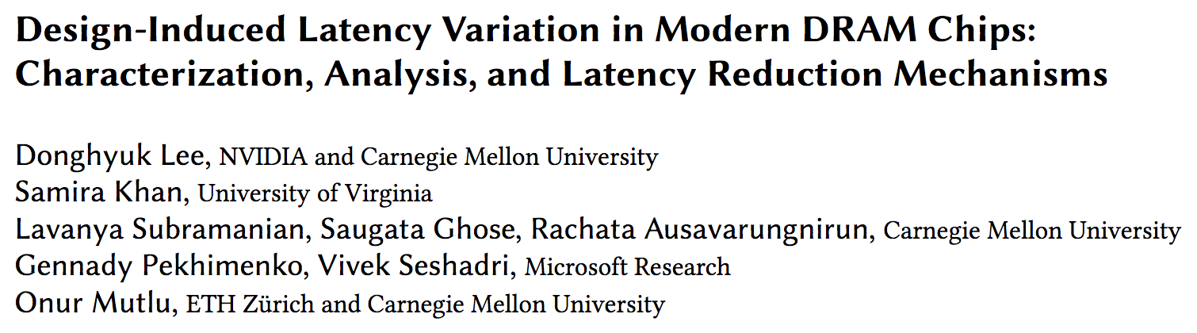
Design-Induced Latency Variation in DRAM
Donghyuk Lee, Samira Khan, Lavanya Subramanian, Saugata Ghose, Rachata Ausavarungnirun, Gennady Pekhimenko, Vivek Seshadri, and Onur Mutlu, "Design-Induced Latency Variation in Modern DRAM Chips: Characterization, Analysis, and Latency Reduction Mechanisms" Proceedings of the ACM International Conference on Measurement and Modeling of Computer Systems (SIGMETRICS), Urbana-Champaign, IL, USA, June 2017.

Slide 100
Understanding & Exploiting the Voltage-Latency-Reliability Relationship

Slide 101
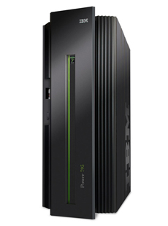
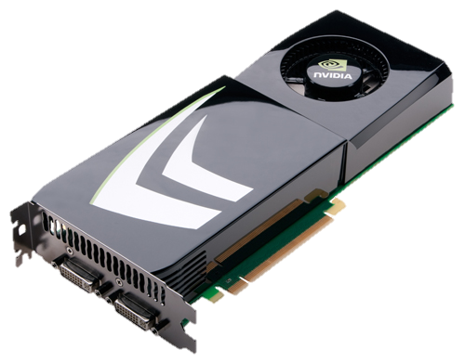
High DRAM Power Consumption
Problem: High DRAM (memory) power in today’s systems
>40% in POWER7 (Ware+, HPCA’10)
>40% in GPU (Paul+, ISCA’15)

Slide 102
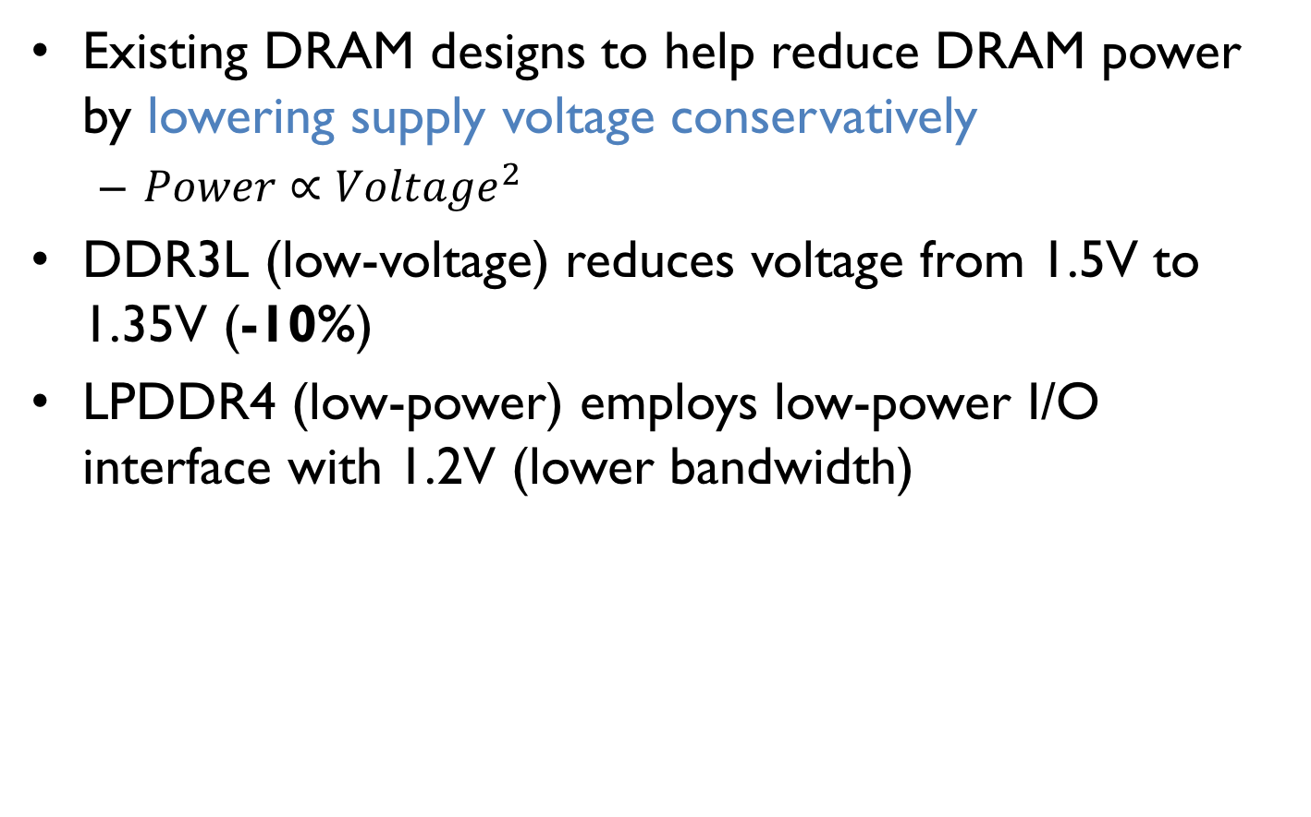
Low-Voltage Memory
Existing DRAM designs to help reduce DRAM power by lowering supply voltage conservatively
$Power∝{Voltage}^{2}$
DDR3L (low-voltage) reduces voltage from 1.5V to 1.35V (-10%)
LPDDR4 (low-power) employs low-power I/O interface with 1.2V (lower bandwidth)
Can we reduce DRAM power and energy by further reducing supply voltage?

Slide 103
Goals
1 Understand and characterize the various characteristics of DRAM under reduced voltage
2 Develop a mechanism that reduces DRAM energy by lowering voltage while keeping performance loss within a target

Slide 104
Key Questions
How does reducing voltage affect reliability (errors)?
How does reducing voltage affect DRAM latency?
How do we design a new DRAM energy reduction mechanism?

Slide 105
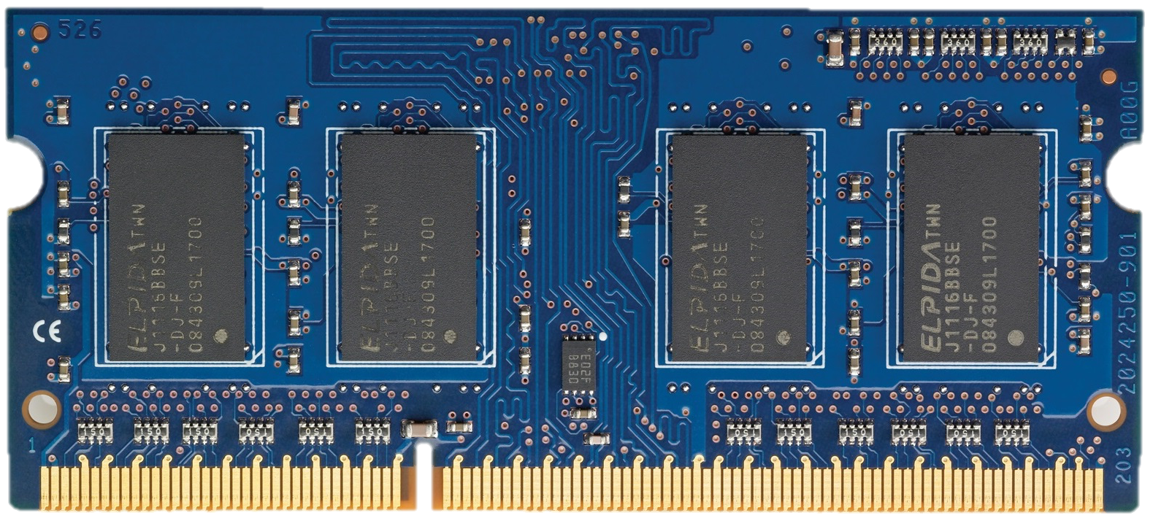
Supply Voltage Control on DRAM
DRAM Module
Supply Voltage
Adjust the supply voltage to every chip on the same module

Slide 106
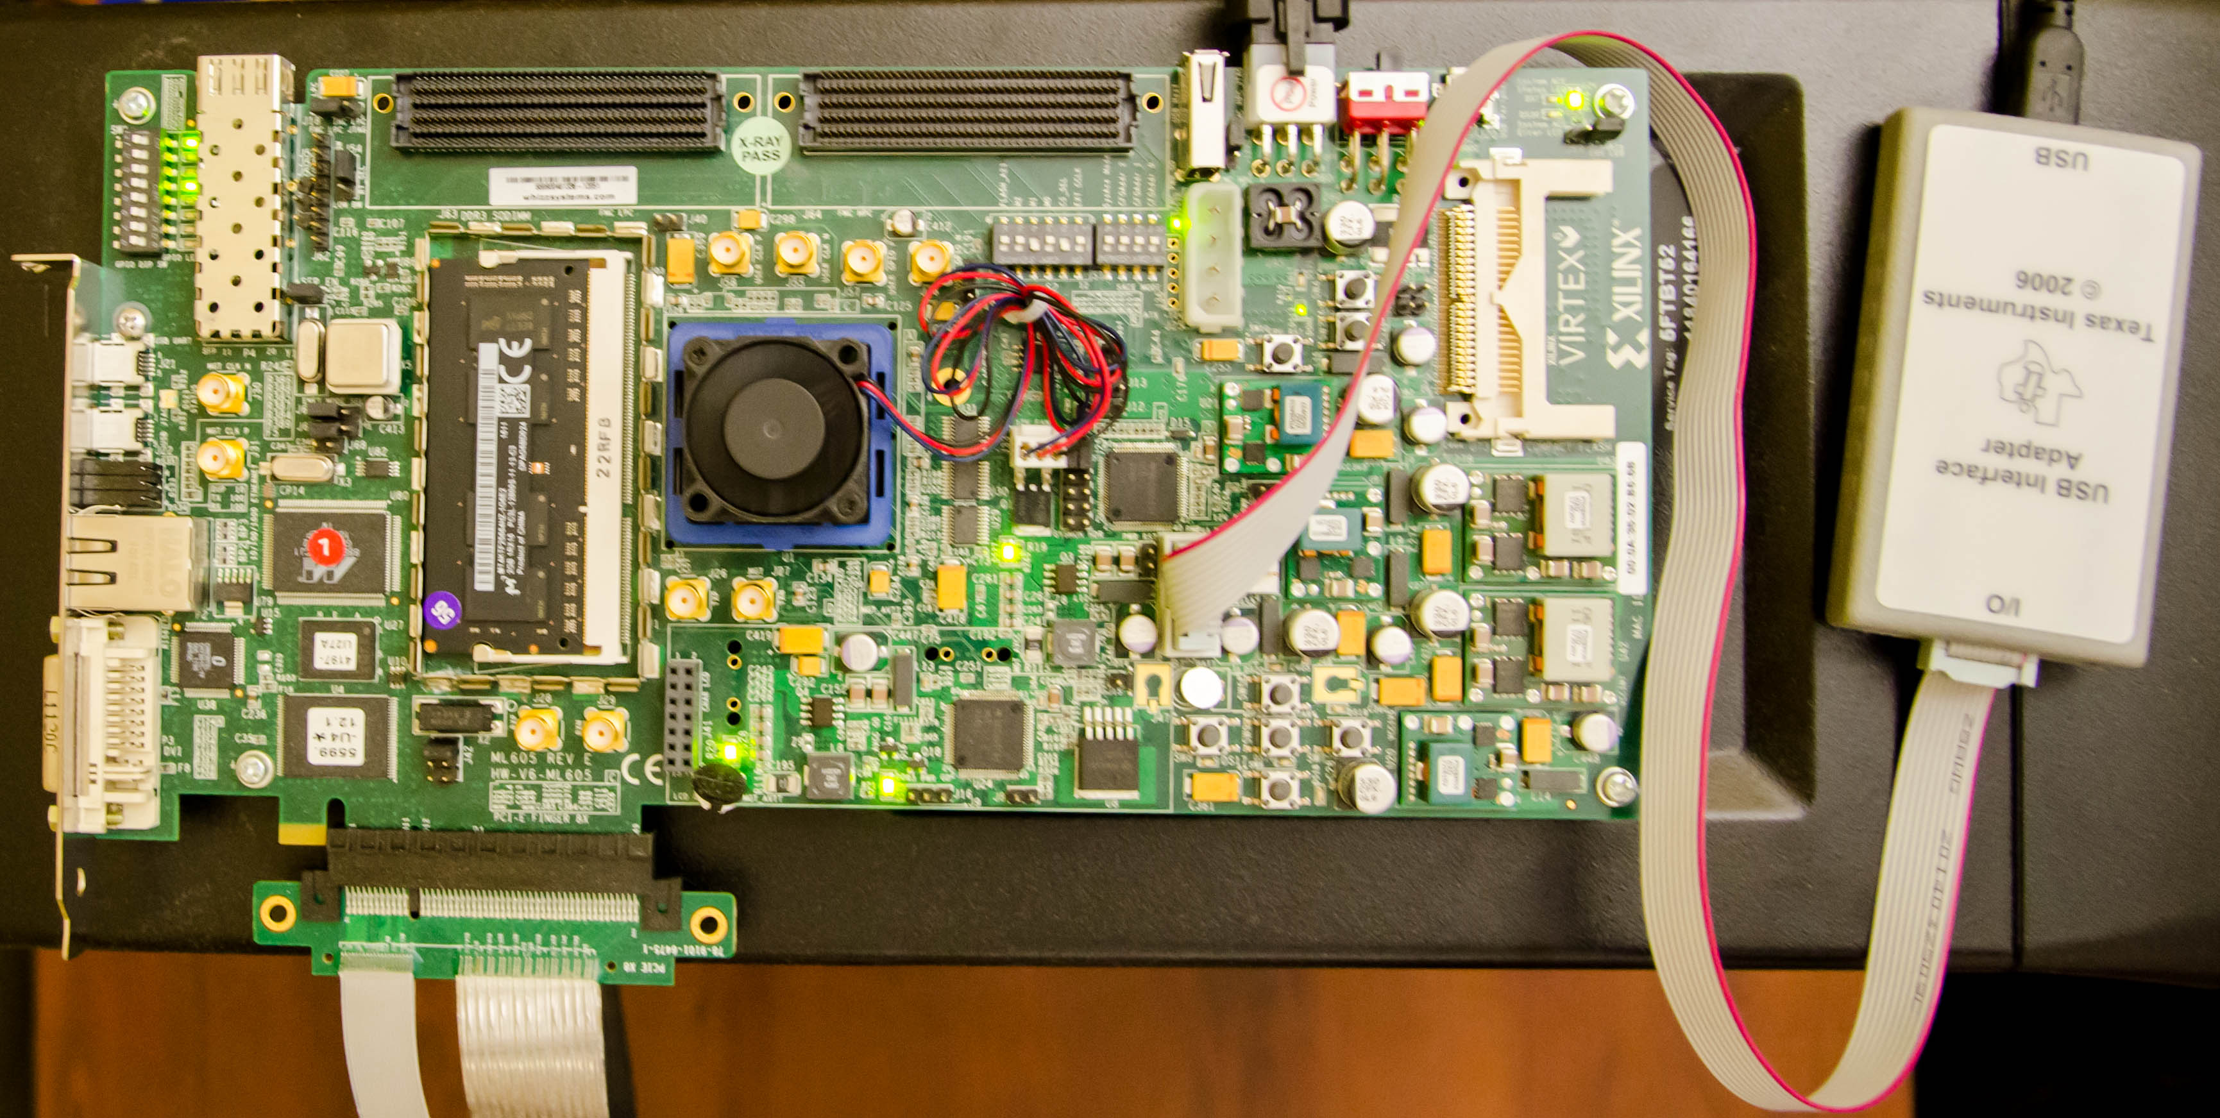
Custom Testing Platform
SoftMC [Hassan+, HPCA’17]: FPGA testing platform to
1) Adjust supply voltage to DRAM modules
2) Schedule DRAM commands to DRAM modules
Existing systems: DRAM commands not exposed to users
DRAM
module
Voltage
controller
FPGA
https://github.com/CMU-SAFARI/DRAM-Voltage-Study

Slide 107
Tested DRAM Modules
124 DDR3L (low-voltage) DRAM chips
31 SO-DIMMs
1.35V (DDR3 uses 1.5V)
Density: 4Gb per chip
Three major vendors/manufacturers
Manufacturing dates: 2014-2016
Iteratively read every bit in each 4Gb chip under a wide range of supply voltage levels: 1.35V to 1.0V (-26%)

Slide 108
Reliability Worsens with Lower Voltage
Errors induced by reduced-voltage operation
Min. voltage (V_{min}) without errors
Nominal Voltage
Reducing voltage below V_{min} causes an increasing number of errors

Slide 109
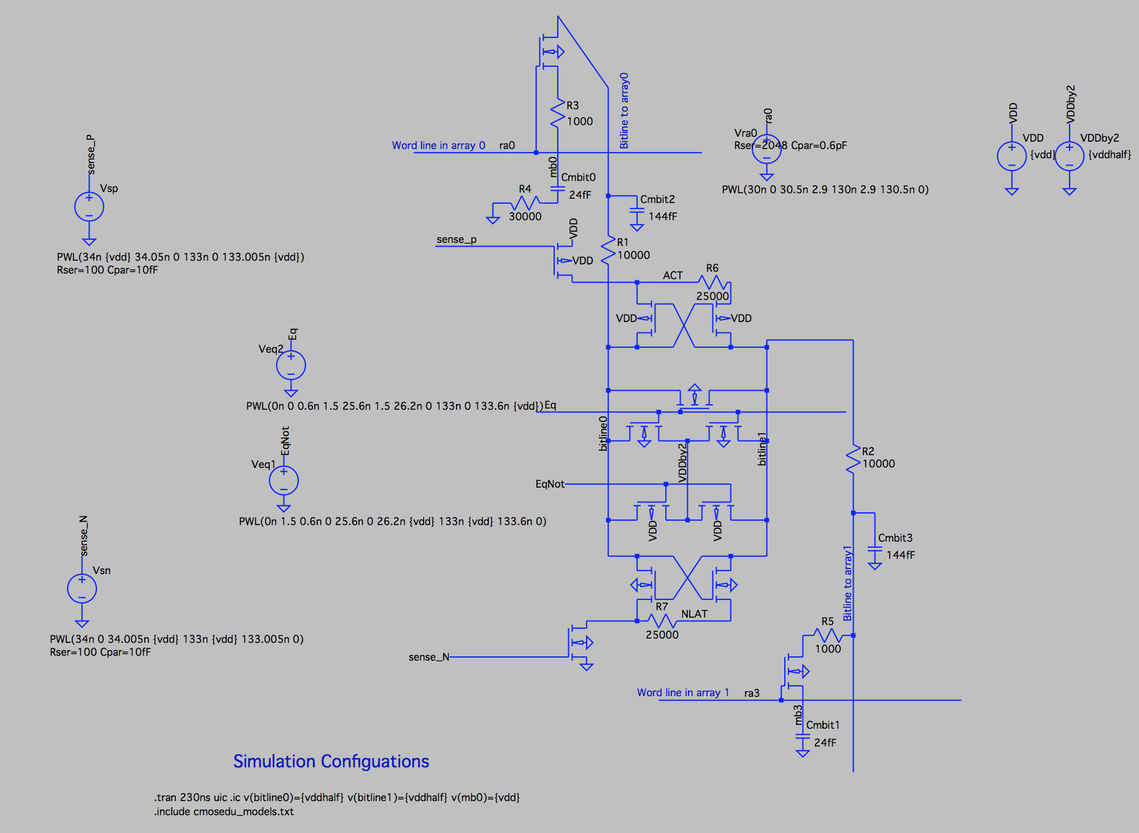
Source of Errors
Detailed circuit simulations (SPICE) of a DRAM cell array to model the behavior of DRAM operations
https://github.com/CMU-SAFARI/DRAM-Voltage-Study
Nominal Voltage
Circuit model
Reliable low-voltage operation requires higher latency

Slide 110
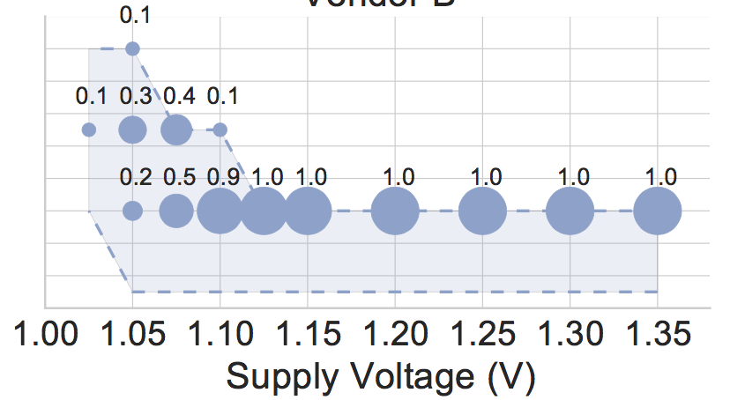
DIMMs Operating at Higher Latency
Measured minimum latency that does not cause errors in DRAM modules
40% of modules
14
Distribution of latency in the total population
100% of modules
Measured Minimum Activate Latency (ns)
12
10
8
DRAM requires longer latency to access data without errors at lower voltage
Lower bound of latency as our latency adjustment granularity is 2.5ns

Slide 111
Spatial Locality of Errors
A module under 1.175V (12% voltage reduction)
Errors concentrate in certain regions

Slide 112
Summary of Key Experimental Observations
Voltage-induced errors increase as voltage reduces further below V_{min}
Errors exhibit spatial locality
Increasing the latency of DRAM operations mitigates voltage-induced errors

Slide 113
DRAM Voltage Adjustment to Reduce Energy
Goal: Exploit the trade-off between voltage and latency to reduce energy consumption
Approach: Reduce DRAM voltage reliably
Performance loss due to increased latency at lower voltage
High Power Savings
Bad Performance
Low Power Savings
Good Performance

Slide 114



Voltron Overview
Voltron
User specifies the performance loss target
Select the minimum DRAM voltage without violating the target
How do we predict performance loss due to increased latency under low DRAM voltage?

Slide 115

Linear Model to Predict Performance
Voltron
User specifies the performance loss target
Select the minimum DRAM voltage without violating the target
Application’s characteristics
Min.
Voltage
Final Voltage
[-1%, -3%, …]
Predicted performance loss
[1.3V, 1.25V, …]
Target
DRAM Voltage
Linear regression model

Slide 116
Regression Model to Predict Performance
Application’s characteristics for the model:
Memory intensity: Frequency of last-level cache misses
Memory stall time: Amount of time memory requests stall commit inside CPU
Handling multiple applications:
Predict a performance loss for each application
Select the minimum voltage that satisfies the performance target for all applications

Slide 117
Comparison to Prior Work
Prior work: Dynamically scale frequency and voltage of the entire DRAM based on bandwidth demand [David+, ICAC’11]
Problem: Lowering voltage on the peripheral circuitry decreases channel frequency (memory data throughput)
Voltron: Reduce voltage to only DRAM array without changing the voltage to peripheral circuitry
Peripheral Circuitry
DRAM Array
Peripheral Circuitry
DRAM Array
Control Logic
Control Logic
Low Voltage
Low Voltage
Bank
Bank
I/O
I/O
Prior Work
Voltron
Off-chip channel
Off-chip channel
Low frequency
High frequency

Slide 118
Exploiting Spatial Locality of Errors
Key idea: Increase the latency only for DRAM banks that observe errors under low voltage
Benefit: Higher performance
Peripheral Circuitry
DRAM Array
Control Logic
Bank 0
Bank 1
Bank 2
I/O
Off-chip channel
High latency
Low latency

Slide 119
Voltron Evaluation Methodology
Cycle-level simulator: Ramulator [CAL’15]
McPAT and DRAMPower for energy measurement
4-core system with DDR3L memory
Benchmarks: SPEC2006, YCSB
Comparison to prior work: MemDVFS [David+, ICAC’11]
Dynamic DRAM frequency and voltage scaling
Scaling based on the memory bandwidth consumption
https://github.com/CMU-SAFARI/ramulator

Slide 120
Energy Savings with Bounded Performance
[David+, ICAC’11]
Meets performance target
7.3%
More savings for high bandwidth applications
-1.6%
-1.8%
3.2%
Performance Target

Slide 121
Voltron: Advantages & Disadvantages
Advantages
+ Can trade-off between voltage and latency to improve energy or performance
+ Can exploit the high voltage margin present in DRAM
Disadvantages
- Requires finding the reliable operating voltage for each chip → higher testing cost

Slide 122
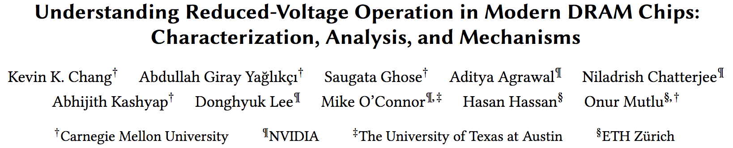
Analysis of Latency-Voltage in DRAM Chips
Kevin Chang, A. Giray Yaglikci, Saugata Ghose, Aditya Agrawal, Niladrish Chatterjee, Abhijith Kashyap, Donghyuk Lee, Mike O'Connor, Hasan Hassan, and Onur Mutlu, "Understanding Reduced-Voltage Operation in Modern DRAM Devices: Experimental Characterization, Analysis, and Mechanisms" Proceedings of the ACM International Conference on Measurement and Modeling of Computer Systems (SIGMETRICS), Urbana-Champaign, IL, USA, June 2017.

Slide 123
And, What If …
… we can sacrifice reliability of some data to access it with even lower latency?

Slide 124




The DRAM Latency PUF: Quickly Evaluating Physical Unclonable Functions by Exploiting the Latency-Reliability Tradeoff in Modern Commodity DRAM Devices
Jeremie S. Kim Minesh Patel
Hasan Hassan Onur Mutlu
Notes:
Hello, my name is Jeremie Kim and I will be talking about the DRAM Latency PUF.

Slide 125
Motivation
We want a way to ensure that a system’s components are not compromised
Physical Unclonable Function (PUF): a function we evaluate on a device to generate a signature unique to the device
We refer to the unique signature as a PUF response
Often used in a Challenge-Response Protocol (CRP)
Input:
Challenge_{X}
Trusted Device
Device
Authenticated
✔
Checking
PUF response
Evaluating
PUF
.
.
Output:
PUF Response_{X}
.
.
.
.
TODO: nice PUF input/output animation showing how a CRP works. Define evaluate, define input, and output (PUF response)
Notes:
[CLICK] We want a way to ensure that a system’s components are not compromised. One example would be if an attacker maliciously swaps a healthy component with a faulty one at runtime in order to steal information. [CLICK] A method for detecting this change in the system would be the use of a physical unclonable function or a PUF. A PUF is a function that we evaluate on a device to generate a signature that is unique to a device. [CLICK] We refer to this unique signature as a PUF response and it reflects the properties inherent In the device, making it unique to the device that generated it. [CLICK] PUFs are often used in a challenge-response protocol (CRP) for device authentication, which works as follows: [CLICK] a trusted device issues an [CLICK] input or a challenge X to the device [CLICK] The device then evaluates the physical unclonable function with the given challenge X, and [CLICK] returns the PUF response X to the trusted device. [CLICK] The trusted server then checks the PUF response, and if it matches the expected response for the given input challenge X, the device will be authenticated and can now be trusted to perform privileged tasks. [CLICK]
====================
[CLICK] A PUF is a function that generates a signature that is unique to a given device. [CLICK] PUFs are often used in a challenge response protocol, which we refer to as a CRP, for authentication. [CLICK] A trusted server, which stores a database of challenges and expected PUF responses, issues a challenge to a device in the form of inputs, or conditions in which the PUF response must be generated. If the device returns the correct PUF response, then the device is authenticated. [CLICK] We need a reliable and fast PUF for systems that use RDMA or perform functions on remote devices or [CLICK] systems with interchangeable system components such as SSD drives

Slide 126
Motivation
We want a runtime-accessible PUF
Should be evaluated quickly with minimal impact on concurrent applications
Can protect against attacks that swap system components with malicious parts
2. DRAM is a promising substrate for evaluating PUFs because it is ubiquitous in modern systems
Unfortunately, current DRAM PUFs are slow and get exponentially slower at lower temperatures
Notes:
[CLICK] First, we want a PUF that is runtime-accessible, which means that the PUF can be evaluated quickly with minimal performance impact on concurrently running applications. [CLICK] The faster you can evaluate a PUF, the earlier you can detect whether a system component has been compromised, and the better you can protect against a wide array of attacks. [CLICK] Secondly, we want to provide a runtime-accessible PUF that can be evaluated on DRAM since it is a ubiquitous memory technology in modern systems today. [CLICK] The problem with current DRAM PUFs, is that they are slow and get exponentially slower at lower temperatures. This is because the speed of their method of generating a unique identifier is inversely affected by temperature.

Slide 127
DRAM Latency Characterization of 223 LPDDR4 DRAM Devices
Latency failures come from accessing DRAM with reduced timing parameters.
Key Observations:
A cell’s latency failure probability is determined by random process variation
Latency failure patterns are repeatable and unique to a device
Notes:
In this work, we show results from a detailed experimental characterization of 223 state-of-the-art LPDDR4 DRAM devices. [CLICK] We characterize DRAM latency by observing the effects of accessing DRAM with DRAM timing parameters reduced below manufacturer-recommended values.
[CLICK] We make two key observations. [CLICK] first, a cell’s probability to fail, when accessed with reduced timing parameters, is directly correlated with random variations that arise from process manufacturing. [CLICK] secondly, We note that these error patterns from inducing DRAM latency errors are unique to a device and highly repeatable.

Slide 128
DRAM Latency PUF Key Idea
A cell’s latency failure probability is inherently related to random process variation from manufacturing
We can provide repeatable and unique device signatures using latency error patterns
High % chance to fail with reduced t_{RCD}
Low % chance to fail with reduced t_{RCD}
Row Decoder
SA
SA
SA
SA
SA
SA
SA
Notes:
Our key idea is to reduce DRAM read access latency below the reliable datasheet specifications using software-only system calls in order to exploit the resulting error patterns as unique identifiers.
[CLICK] We find that the probability that a cell will result in a latency failure due to a reduced-tRCD access, is inherently related to random process variation from manufacturing [CLICK] This knowledge enables us to provide a repeatable and unique device signature with these patterns of latency failures.
[CLICK] Here is a cartoon showing the manufacturing variation across a region of DRAM. When accessed with a reduced timing parameter, [CLICK] some cells have a high percentage chance of failing, while others [CLICK] have a low percentage chance of failing.
The Key Idea is to generate a PUF response using the locations of cells that have a high percentage chance of failing with a tRCD value reduced below manufacturer-recommended values.

Slide 129
DRAM Latency PUF Key Idea
A cell’s latency failure probability is inherently related to random process variation from manufacturing
We can provide repeatable and unique device signatures using latency error patterns
The key idea is to compose a PUF response using the DRAM cells that fail
with high probability
High % chance to fail with reduced t_{RCD}
Low % chance to fail with reduced t_{RCD}
Row Decoder
SA
SA
SA
SA
SA
SA
SA
Notes:
Our key idea is to reduce DRAM read access latency below the reliable datasheet specifications using software-only system calls in order to exploit the resulting error patterns as unique identifiers.
[CLICK] We find that the probability that a cell will result in a latency failure due to a reduced-tRCD access, is inherently related to random process variation from manufacturing [CLICK] This knowledge enables us to provide a repeatable and unique device signature with these patterns of latency failures.
[CLICK] Here is a cartoon showing the manufacturing variation across a region of DRAM. When accessed with a reduced timing parameter, [CLICK] some cells have a high percentage chance of failing, while others [CLICK] have a low percentage chance of failing.
The Key Idea is to generate a PUF response using the locations of cells that have a high percentage chance of failing with a tRCD value reduced below manufacturer-recommended values.

Slide 130
DRAM Accesses and Failures
wordline
V_{dd}
access
transistor
V_{min}
Ready to Access
Voltage Level
bitline
Process variation during manufacturing leads to cells having unique characteristics
Bitline Voltage
Bitline Charge Sharing
capacitor
SA
0.5 V_{dd}
Time
ACTIVATE
SA Enable
READ
t_{RCD}
Notes:
[CLICK] A DRAM cell holds its charge in a capacitor and gets read out by the sense amplifier via the bitline. [CLICK][CLICK] Initially the bitline is kept at Vdd/2. [CLICK] When the wordline is driven high or activated, [CLICK] the capacitor begins to share charge with the bitline. The sense amplifier is then enabled and [CLICK] the voltage differential on the bitline is amplified to an I/O readable value. [CLICK] In order to ensure correctness of operation, the memory controller can only read data tRCD time after the activation. [CLICK] We could read this data earlier, when it reaches a readable voltage threshold, [CLICK] but other cells, that are weaker due to process variation, might fail. [CLICK]

Slide 131
DRAM Accesses and Failures
wordline
V_{dd}
access
transistor
V_{min}
Ready to Access
Voltage Level
bitline
weaker cells have a higher probability to fail
Bitline Voltage
capacitor
SA
0.5 V_{dd}
Time
ACTIVATE
SA Enable
READ
t_{RCD}
Notes:
Our method of inducing latency errors is to [CLICK] reduce tRCD below manufacturer-recommended values. Cells that are read when their bitline’s voltage is lower than the threshold, have a probability of failure. This probability increases as you read further below the voltage threshold.

Slide 132
The DRAM Latency PUF Evaluation
We generate PUF responses using latency errors in a region of DRAM
The latency error patterns satisfy PUF requirements
The DRAM Latency PUF generates PUF responses in 88.2ms
Notes:
[CLICK] The DRAM latency PUF generates a PUF response by inducing latency errors in a region of DRAM. [CLICK] We find that the error patterns from latency errors in a DRAM region satisfy the requirements for an effective PUF quite well. [CLICK] The DRAM latency PUF can generate a PUF response in 88.2ms.

Slide 133
Results – PUF Evaluation Latency
8KiB memory segment
33,806.6x
318.3x
8KiB memory segment
DRAM latency PUF is
1. Fast and constant latency (88.2ms)
Can evaluate a DRAM Latency PUF (88ms) orders of magnitudes faster (152x/1426x at 55°C/70°C) than the prior best DRAM PUF with the same memory segment size
Notes:
[CLICK] We next show the same retention PUF evaluation time figure as before, but now we overlay the execution time of our DRAM latency PUF proposal. Remember that the y axis is a log scale. Our PUF memory segment has significantly lower overhead in terms of evaluation time and system interference compared to the DRAM retention PUF. The DRAM latency PUF can be evaluated in an average of 88ms regardless of the temperature. This is because, unlike the DRAM retention PUF, the speed of inducing latency failures is NOT dependent on temperature.
[CLICK] We find that we can evaluate a DRAM latency PUF on DRAM orders of magnitudes faster than the prior best DRAM PUF with the same memory segment size. We achieve a speedup of 152x at 55C and 1426x at 70C.
TODO: draw first banner at the bottom after the first line of DRAM latency PUF .
OK lets look at DRAM retention PUF with the same overhead 8KB memory segment. annotate figure showing the 1426x, and show the 70C speedup.
annotate the figure showing the speedup for manufacturer A. Even with 64MiB, we still have this speeedup. remove the numbers after showing all manufactuers. This is similar across all manufacturer. across all manufactures here is average with same storeage overhead.
8KiB 55 -> 33806.6x 70 -> 318.3x 64KiB 55 -> 869.8x 70 -> 108.93x 64MiB 55 -> 17.31x 70 -> 11.487x

Slide 134
Results – PUF Evaluation Latency
8KiB memory segment
64KiB memory segment
869.8x
108.9x
8KiB memory segment
DRAM latency PUF is
1. Fast and constant latency (88.2ms)
Can evaluate a DRAM Latency PUF (88ms) orders of magnitudes faster (152x/1426x at 55°C/70°C) than the prior best DRAM PUF with the same memory segment size
Notes:
[CLICK] We next show the same retention PUF evaluation time figure as before, but now we overlay the execution time of our DRAM latency PUF proposal. Remember that the y axis is a log scale. Our PUF memory segment has significantly lower overhead in terms of evaluation time and system interference compared to the DRAM retention PUF. The DRAM latency PUF can be evaluated in an average of 88ms regardless of the temperature. This is because, unlike the DRAM retention PUF, the speed of inducing latency failures is NOT dependent on temperature.
[CLICK] We find that we can evaluate a DRAM latency PUF on DRAM orders of magnitudes faster than the prior best DRAM PUF with the same memory segment size. We achieve a speedup of 152x at 55C and 1426x at 70C.
TODO: draw first banner at the bottom after the first line of DRAM latency PUF .
OK lets look at DRAM retention PUF with the same overhead 8KB memory segment. annotate figure showing the 1426x, and show the 70C speedup.
annotate the figure showing the speedup for manufacturer A. Even with 64MiB, we still have this speeedup. remove the numbers after showing all manufactuers. This is similar across all manufacturer. across all manufactures here is average with same storeage overhead.
8KiB 55 -> 33806.6x 70 -> 318.3x 64KiB 55 -> 869.8x 70 -> 108.93x 64MiB 55 -> 17.31x 70 -> 11.487x

Slide 135
Results – PUF Evaluation Latency
8KiB memory segment
64KiB memory segment
64MiB memory segment
17.3x
11.5x
8KiB memory segment
DRAM latency PUF is
1. Fast and constant latency (88.2ms)
Can evaluate a DRAM Latency PUF (88ms) orders of magnitudes faster (152x/1426x at 55°C/70°C) than the prior best DRAM PUF with the same memory segment size
Notes:
[CLICK] We next show the same retention PUF evaluation time figure as before, but now we overlay the execution time of our DRAM latency PUF proposal. Remember that the y axis is a log scale. Our PUF memory segment has significantly lower overhead in terms of evaluation time and system interference compared to the DRAM retention PUF. The DRAM latency PUF can be evaluated in an average of 88ms regardless of the temperature. This is because, unlike the DRAM retention PUF, the speed of inducing latency failures is NOT dependent on temperature.
[CLICK] We find that we can evaluate a DRAM latency PUF on DRAM orders of magnitudes faster than the prior best DRAM PUF with the same memory segment size. We achieve a speedup of 152x at 55C and 1426x at 70C.
TODO: draw first banner at the bottom after the first line of DRAM latency PUF .
OK lets look at DRAM retention PUF with the same overhead 8KB memory segment. annotate figure showing the 1426x, and show the 70C speedup.
annotate the figure showing the speedup for manufacturer A. Even with 64MiB, we still have this speeedup. remove the numbers after showing all manufactuers. This is similar across all manufacturer. across all manufactures here is average with same storeage overhead.
8KiB 55 -> 33806.6x 70 -> 318.3x 64KiB 55 -> 869.8x 70 -> 108.93x 64MiB 55 -> 17.31x 70 -> 11.487x

Slide 136
Results – PUF Evaluation Latency
8KiB memory segment
64KiB memory segment
64MiB memory segment
8KiB memory segment
DRAM latency PUF is
1. Fast and constant latency (88.2ms)
2. On average, 102x/860x faster than the previous
DRAM PUF with the same DRAM capacity overhead (64KiB)
Can evaluate a DRAM Latency PUF (88ms) orders of magnitudes faster (152x/1426x at 55°C/70°C) than the prior best DRAM PUF with the same memory segment size
Notes:
[CLICK] We next show the same retention PUF evaluation time figure as before, but now we overlay the execution time of our DRAM latency PUF proposal. Remember that the y axis is a log scale. Our PUF memory segment has significantly lower overhead in terms of evaluation time and system interference compared to the DRAM retention PUF. The DRAM latency PUF can be evaluated in an average of 88ms regardless of the temperature. This is because, unlike the DRAM retention PUF, the speed of inducing latency failures is NOT dependent on temperature.
[CLICK] We find that we can evaluate a DRAM latency PUF on DRAM orders of magnitudes faster than the prior best DRAM PUF with the same memory segment size. We achieve a speedup of 152x at 55C and 1426x at 70C.
TODO: draw first banner at the bottom after the first line of DRAM latency PUF .
OK lets look at DRAM retention PUF with the same overhead 8KB memory segment. annotate figure showing the 1426x, and show the 70C speedup.
annotate the figure showing the speedup for manufacturer A. Even with 64MiB, we still have this speeedup. remove the numbers after showing all manufactuers. This is similar across all manufacturer. across all manufactures here is average with same storeage overhead.
8KiB 55 -> 33806.6x 70 -> 318.3x 64KiB 55 -> 869.8x 70 -> 108.93x 64MiB 55 -> 17.31x 70 -> 11.487x

Slide 137
Other Results in the Paper
How the DRAM latency PUF meets the basic requirements for an effective PUF
A detailed analysis on:
Devices of the three major DRAM manufacturers
The evaluation time of a PUF
Further discussion on:
Optimizing retention PUFs
System interference of DRAM retention and latency PUFs
Algorithm to quickly and reliably evaluate DRAM latency PUF
Design considerations for a DRAM latency PUF
The DRAM Latency PUF overhead analysis
Notes:
Othlller results that are included in the paper include the following:
[CLICK] An analysis on how the DRAM latency PUF meets the basic requirements for an effective PUF.
[CLICK] A detailed analysis on
[CLICK] devices from the three major DRAM manufacturers
[CLICK] the evaluation time of a DRAM latency PUF
[CLICK] A further discussion on
[CLICK] how one could optimize a DRAM retention PUF
[CLICK] the system interference of both DRAM retention and latency PUFs
[CLICK] an algorithm for quickly and reliably evaluating DRAM latency PUFs
[CLICK] design considerations for a DRAM latency PUF

Slide 138

The DRAM Latency PUF: Quickly Evaluating Physical Unclonable Functions by Exploiting the Latency-Reliability Tradeoff in Modern Commodity DRAM Devices
Jeremie S. Kim Minesh Patel
Hasan Hassan Onur Mutlu
HPCA 2018
QR Code for the paper
https://people.inf.ethz.ch/omutlu/pub/dram-latency-puf_hpca18.pdf
Notes:
Please come to my talk at HPCA 2018, if you would like to learn more or have any questions. Thank you very much.

Slide 139
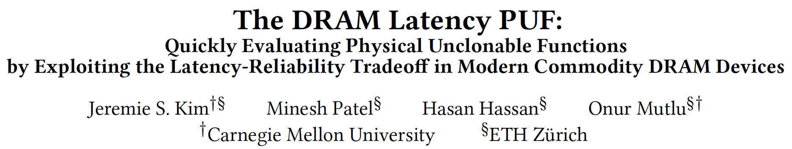
DRAM Latency PUFs
Jeremie S. Kim, Minesh Patel, Hasan Hassan, and Onur Mutlu, "The DRAM Latency PUF: Quickly Evaluating Physical Unclonable Functions by Exploiting the Latency-Reliability Tradeoff in Modern DRAM Devices" Proceedings of the 24th International Symposium on High-Performance Computer Architecture (HPCA), Vienna, Austria, February 2018. [Lightning Talk Video] [Slides (pptx) (pdf)] [Lightning Session Slides (pptx) (pdf)]

Slide 140
Reducing Refresh Latency

Slide 141
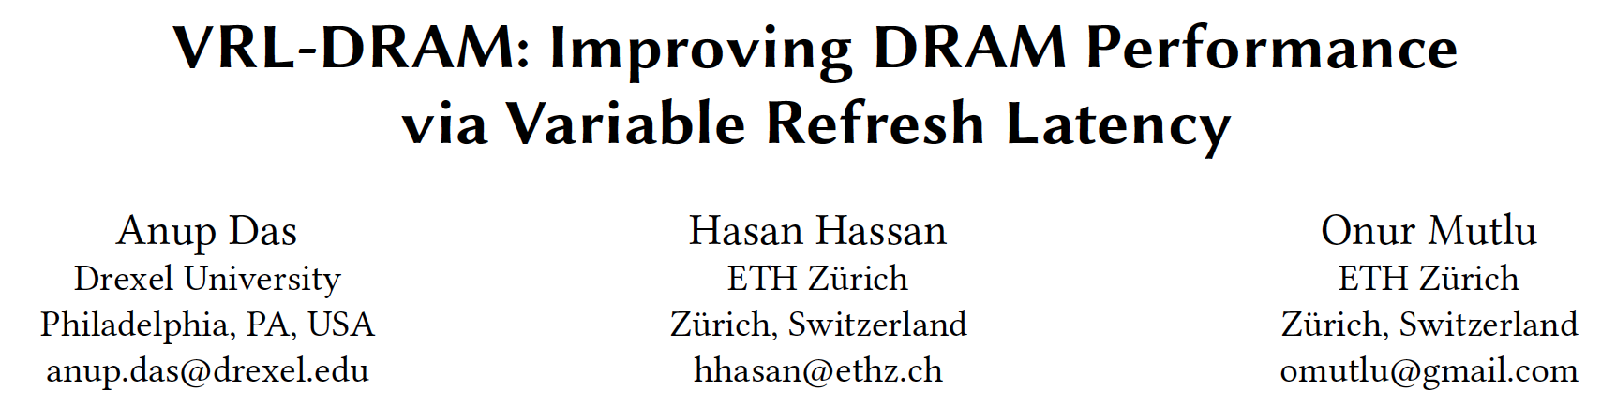
On Reducing Refresh Latency
Anup Das, Hasan Hassan, and Onur Mutlu, "VRL-DRAM: Improving DRAM Performance via Variable Refresh Latency" Proceedings of the 55th Design Automation Conference (DAC), San Francisco, CA, USA, June 2018.

Slide 142
Reducing Memory Latency by Exploiting Memory Access Patterns

Slide 143
ChargeCache: Executive Summary
Goal: Reduce average DRAM access latency with no modification to the existing DRAM chips
Observations:
A highly-charged DRAM row can be accessed with low latency
A row’s charge is restored when the row is accessed
A recently-accessed row is likely to be accessed again:
Row Level Temporal Locality (RLTL)
Key Idea: Track recently-accessed DRAM rows and use lower timing parameters if such rows are accessed again
ChargeCache:
Low cost & no modifications to the DRAM
Higher performance (8.6-10.6% on average for 8-core)
Lower DRAM energy (7.9% on average)
Notes:
Let’s first take a high level glance at this work.
[CLICK]
DRAM latency is a critical bottleneck for system performance. Given that the DRAM chips are difficult to change, our goal in this work is to reduce average DRAM access latency with no modifications to the existing DRAM chips.
[CLICK]
We achieve that goal by exploiting three key observations.
First, a highly-charged DRAM row can be accessed with low latency.
Second, a row’s charge is restored when the row is accessed.
Third, we find that a recently-accessed row is likely to be accessed again. We call that
Row Level Temporal Locality and we find that many applications, both single-core and multi-core, exhibit that phenomenon.
Based on that we develop the key idea of ChargeCache.
The key idea is to track recently-accessed rows and use lower timing parameters if they are accessed again.
We show that ChargeCache is low cost and requires no modifications to the existing DRAM chips.
According to our evaluations, ChargeCache improves performance between 8.6% and 10.6% on average for 8-core system, depending on the ChargeCache capacity. It also saves 7.9% energy on average.

Slide 144
DRAM Charge over Time
Ready to Access
Ready to
Precharge
Ready to Access
Charge Level
Cell
Cell
Data 1
charge
Sense-Amplifier
Data 0
Sense
Amplifier
Sensing
Restore
Precharge
time
tRCD
ACT
R/W
PRE
tRAS
Notes:
Let’s look at the same phases from the charge level perspective.
[CLICK]
The figure shows the change of charge levels of a DRAM Cell and Sense Amplifier in Y-axis, and the time in X-axis.
Initially, our cell contains charge that matches the region of Data 1, which can be treated as 0 or 1.
[CLICK]
To access the data stored in the cell, the charge of the sense amplifier should reach «Read to Access Charge Level».
The memory controller initiates Sensing phase by issuing Activate command.
On Sensing, the charge is transferred from the Cell to the Sense-Amplifier.
That slightly increases the charge of the Sense Amplifier. When the Sense Amplifier reaches
The threshold charge to recognize the data, Sensing phase finishes and Restore begins.
[CLICK]
During restore, both the
Sense Amplifier and the DRAM cell are driven back to fully charged state.
At the point where the sense amplifier reaches «ready to access charge level», the
Memory controller is free to issue Read or Write command.
[CLICK]
The time passed since ACT to READ or WRITE is called tRCD. [CLICK]
At the end of restore, the memory controller could issue PRE command if needed. [CLICK]
That triggers the Precharge phase where the Sense Amplifier charge gets back to its pre-sensing value.
The time from the start of the Sensing upon the completion of Restore is called tRAS. [CLICK]
The main takeaway in this slide is that the memory controller accesses DRAM using DRAM commands and determines the Access latency by satisfying the timing parameters.

Slide 145
Accessing Highly-charged Rows
Ready to Access
Ready to Precharge
Cell
Data 1
charge
Sense-Amplifier
Data 0
Sensing
Restore
Precharge
time
tRCD
ACT
R/W
R/W
PRE
PRE
tRAS
Notes:
The blue dots show the points where the sense amplifier reaches ready to access
And ready to precharge charge levels for a cell with the current initial charge.
Now, Let’s see how these points change when accessing a cell with higher initial charge.
[CLICK]
When the cell’s initial charge is close to the maximum level, Sensing and Restore phases
complete quicker. Hence, READ or WRITE and PRE commands can be issued
Eairlier. That corresponds to reduction on tRCD and tRAS timing parameters.
[CLICK]
Please refer to our paper to get more detailed explanation for that phenomenon.

Slide 146
Observation 1
A highly-charged DRAM row can be accessed with low latency
tRCD: 44%
tRAS: 37%
How does a row become highly-charged?
Notes:
So, we can access highly-charged rows faster.
[CLICK]
According to our SPICE simulations, highly-charged rows can be accessed
With 44% lower tRCD and 37% lower tRAS.
[CLICK]
Now, the question is: «How does a row become highly-charged?»

Slide 147
How Does a Row Become Highly-Charged?
DRAM cells lose charge over time
Two ways of restoring a row’s charge:
Refresh Operation
Access
charge
Refresh
Access
Refresh
time
Notes:
One thing to note is that DRAM cells are leaky, which means they lose charge over time.
To reliably store the data, cell’s charge needs to be restored.
[CLICK]
There are two ways of restoring the charge of the cells in a DRAM row. [CLICK]
The memory controller periodically issues REFRESH commands to continuously preserve data in DRAM.
[CLICK]
Second, as I showed in the previous slides, data accesses also inherently replenish the charge of the Cells.
As a result, we could know that the cell is in highly-charged state, if it was either recently refreshed Or recently-accessed.

Slide 148
Observation 2
A row’s charge is restored when the row is accessed
How likely is a recently-accessed row to be accessed again?
Notes:
So, a row’s charge is restored when the row is accessed.
And now the question is: «How likely is a recently-accessed row to be accessed again?»

Slide 149
Row Level Temporal Locality (RLTL)
A recently-accessed DRAM row is likely to be accessed again.
t-RLTL: Fraction of rows that are accessed within time t after their previous access
86%
97%
8ms – RLTL for single-core workloads
8ms – RLTL for eight-core workloads
Notes:
We observe that when DRAM row is accessed, it is likely
to be accessed again. We call this phenomenon Row Level Temporal Locality (RLTL).
We define t-RLTL of an application,
as the fraction of rows that are accessed within time t after their previous access.
If an application has high RLTL for low T time, that application mostly accesses highly-charged DRAM rows, since the rows preserve most of their charge until the next access, which happens in a very Short interval.
Now, I’ll show the RLTL characteristics of 22 single-core workloads that we evaluted.
On Y-axis we have the fraction of accesses and on the X-axis we have the workloads.
[CLICK]
Our results show that, on average, 86% of the accesses are made to rows previously accessed within 8 ms.
Only one application has low RLTL. It is because that application makes very
Few accesses to the memory since it highly benefits from the caches.
For eight-core evaluations, the applications show even higher RLTL, 97%. It is due to the interference that the simultaneously runnning applications create on the memory.

Slide 150
Key Idea
Track recently-accessed DRAM rows and use lower timing parameters if such rows are accessed again
Notes:
The key idea of our mechanism is to
Track recently-accessed DRAM rows and use lower timing parameters
if such rows are accessed again.

Slide 151

ChargeCache Overview
DRAM
:A
Memory Controller
:B
ChargeCache
:C
A
:D
D
:E
:F
Requests:
A
D
A
Use Lower Timings
ChargeCache Miss:
Use Default Timings
ChargeCache Hit:
Notes:
We named our mechanism ChargeCache as it provides a cache-like benefit by reducing access
Latency and does so by taking advantage of the charge level stored in the row.
Now, I will demonstrate how ChargeCache works.
We have ChargeCache inside the Memory Controller.
On the right, you see a respesentation of DRAM where we have rows labeled from A to F.
[CLICK]
When the memory controller receives the first request to row A, it serves that request with typical timing parameters since we have
Nothing in ChargeCache. When
The request completes, it inserts the row address to one of the ChargeCache entries since we know that the row is highly-charged at that time. So, after that point,
The first entry points to Row A.
[CLICK]
The next request targets Row D. The memory controller probes the ChargeCache. It misses since we have only
Row A there. Similarly, Row D is inserted to ChargeCache.
[CLICK]
However, when we receive a request targetting row that we have in ChargeCache, the memory controller knows that the access
Goes to a highly-charged Row and tunes the DRAM Timing parameters to lower the access latency.
If there are not incoming requests to the Rows stored in ChargeCache for a long time, these rows will leak significant
Amount of charge and won’t be highly-charged rows anymore. For that reason, they need to be discarded from ChargeCache. [CLICK]
ChargeCache implements a low-cost mechanism to automatically invalidate its entries to ensure that its entries always
Point to highly-charged rows.

Slide 152
Area and Power Overhead
Modeled with CACTI
Area
~5KB for 128-entry ChargeCache
0.24% of a 4MB Last Level Cache (LLC) area
Power Consumption
0.15 mW on average (static + dynamic)
0.23% of the 4MB LLC power consumption
Notes:
ChargeCache improves average DRAM access latency with low area and
Power consumption overhead. We evaluated that using CACTI tool.
A 128-entry ChargeCache totally requires only approximately 5KB of storage.
That is equal to 0.24% of the area of a 4MB Last Level Cache.
According to our evaluations, ChargeCache consumes only total 0.15 milli watts
Power on average. That is equal to 0.23% of the power consumption of a 4MB LLC.
We conclude that ChargeCache is a low cost mechanism in terms of area requirement and
Power consumption.

Slide 153
Methodology
Simulator
DRAM Simulator (Ramulator [Kim+, CAL’15])
https://github.com/CMU-SAFARI/ramulator
Workloads
22 single-core workloads
SPEC CPU2006, TPC, STREAM
20 multi-programmed 8-core workloads
By randomly choosing from single-core workloads
Execute at least 1 billion representative instructions per core (Pinpoints)
System Parameters
1/8 core system with 4MB LLC
Default tRCD/tRAS of 11/28 cycles
Notes:
To evaluate ChargeCache, we used Ramulator, a cycle-accurate DRAM simulator.
For single-core evaluations, we analyzed 22 workloads from benchmark sets SPEC2006, TPC, and STREAM.
For multi-core evaluations we analyzed 20 multi-programmed workloads by assigning randomly-chosen
Single-core workload to each core.
For all workloads, we executed at least 1 billion representative instructions per core that we obtained using Pinpoints.
We evaluated both single and eight core systems with 4MB shared LLC.
Default tRCD and tRAS timings are 11 and 28 cycles respectively.

Slide 154
Single-core Performance
NUAT
ChargeCache
ChargeCache + NUAT
LL-DRAM (Upper bound)
ChargeCache improves
single-core performance
Notes:
Lets see how these mechanisms perform in single-core systems.
Here, on the Y-axis we have speedup and on the X-axis we have the workloads.
On this slide I show results for 10 most memory intensive workloads. However, the
Average includes all 22 applications that we evaluate.
As you see, NUAT improves performance slightly as expected.
On the other hand, ChargeCache significantly outperforms NUAT.
When used in combination, ChargeCache and NUAT provides some improvement over ChargeCache alone.
And LL-DRAM shows the maximum level of performance that we can achieve assuming all the rows are Highly-charged.
Generally, ChargeCache performs relatively close to LL-DRAM with a few exceptions. ChargeCache cannot perform As good as LL-DRAM because these workloads have significantly large working set which does not fit well in ChargeCache. We have analysis on ChargeCache with larger capacities in our paper.
So, as a conclusion, we can say that ChargeCache improves single-core performance.

Slide 155
Eight-core Performance
NUAT
2.5%
ChargeCache
9%
ChargeCache + NUAT
LL-DRAM (Upperbound)
13%
ChargeCache significantly improves multi-core performance
Notes:
For eight-core workloads, we again show only results for 10 most memory intensive workloads
And provide average of all 20 multi-programmed workloads we evalated.
NUAT again performs here relatively poorly and achieves only up to 2.5% speedup on average.
ChargeCache performs significantly better than NUAT. With eight-core workloads, ChargeCache
Achieves 9% improvement, on average.
ChargeCache performs better in eight-core systems due to interference that simultaneously running cores create on the main memory subsystem.
ChargeCache and NUAT, can improve the performance more when used together.
And finally LL-DRAM shows the upper bound that we can achieve. ChargeCache covers a relatively large portion of the performance that a LL-DRAM can provide.
We conclude that ChargeCache significantly improves multi-core performance.

Slide 156
DRAM Energy Savings
ChargeCache reduces DRAM energy
Notes:
ChargeCache provides energy savings due to the reduced execution time.
Here we show the average and maximum energy savings on the DRAM subsystem
For both single-core and eight-core evaluations.
ChargeCache can save up to almost 15% energy on the DRAM subsystem.
Note that, we also get system-wide energy savings due to the reduced execution time.
So, we conclude that ChargeCache saves DRAM energy.

Slide 157
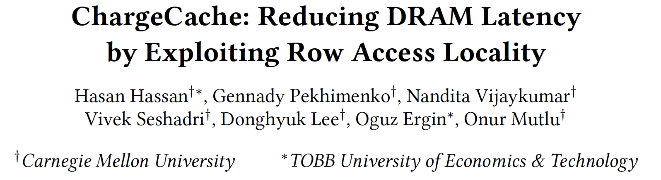
More on ChargeCache
Hasan Hassan, Gennady Pekhimenko, Nandita Vijaykumar, Vivek Seshadri, Donghyuk Lee, Oguz Ergin, and Onur Mutlu, "ChargeCache: Reducing DRAM Latency by Exploiting Row Access Locality" Proceedings of the 22nd International Symposium on High-Performance Computer Architecture (HPCA), Barcelona, Spain, March 2016. [Slides (pptx) (pdf)] [Source Code]

Slide 158
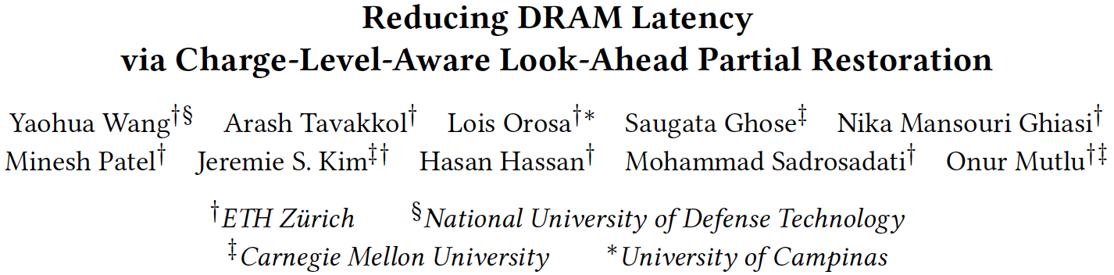
A Very Recent Work
Yaohua Wang, Arash Tavakkol, Lois Orosa, Saugata Ghose, Nika Mansouri Ghiasi, Minesh Patel, Jeremie S. Kim, Hasan Hassan, Mohammad Sadrosadati, and Onur Mutlu, "Reducing DRAM Latency via Charge-Level-Aware Look-Ahead Partial Restoration" Proceedings of the 51st International Symposium on Microarchitecture (MICRO), Fukuoka, Japan, October 2018.

Slide 159
On DRAM Power Consumption

Slide 160
Summary: Low-Latency Memory

Slide 161
Summary: Tackling Long Memory Latency
Reason 1: Design of DRAM Micro-architecture
Goal: Maximize capacity/area, not minimize latency
Reason 2: “One size fits all” approach to latency specification
Same latency parameters for all temperatures
Same latency parameters for all DRAM chips (e.g., rows)
Same latency parameters for all parts of a DRAM chip
Same latency parameters for all supply voltage levels
Same latency parameters for all application data
…

Slide 162
Challenge and Opportunity for Future
Fundamentally
Low Latency
Computing Architectures

Slide 163
On DRAM Power Consumption

Slide 164
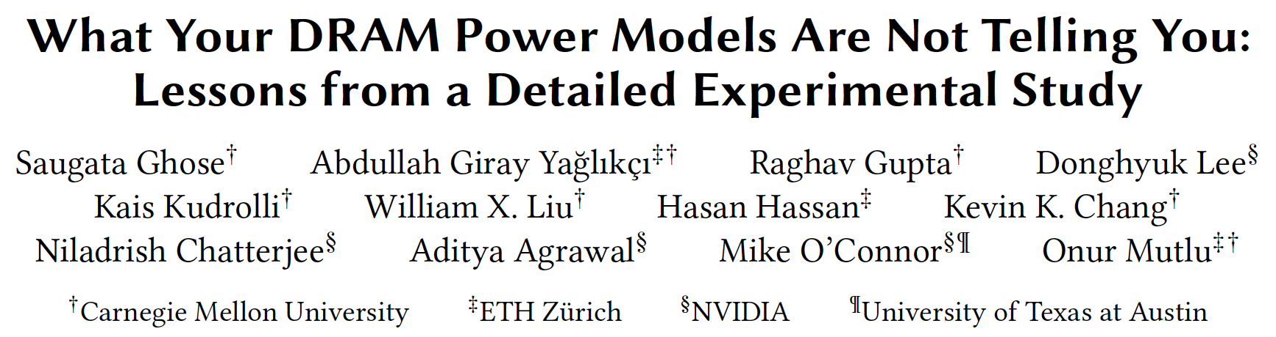
VAMPIRE DRAM Power Model
Saugata Ghose, A. Giray Yaglikci, Raghav Gupta, Donghyuk Lee, Kais Kudrolli, William X. Liu, Hasan Hassan, Kevin K. Chang, Niladrish Chatterjee, Aditya Agrawal, Mike O'Connor, and Onur Mutlu, "What Your DRAM Power Models Are Not Telling You: Lessons from a Detailed Experimental Study" Proceedings of the ACM International Conference on Measurement and Modeling of Computer Systems (SIGMETRICS), Irvine, CA, USA, June 2018. [Abstract]

Slide 165
Conclusion

Slide 166
Four Key Directions
Fundamentally Secure/Reliable/Safe Architectures
Fundamentally Energy-Efficient Architectures
Memory-centric (Data-centric) Architectures
Fundamentally Low-Latency Architectures
Architectures for Genomics, Medicine, Health

Slide 167
Some Solution Principles (So Far)
Data-centric system design & intelligence spread around
Do not center everything around traditional computation units
Better cooperation across layers of the system
Careful co-design of components and layers: system/arch/device
Better, richer, more expressive and flexible interfaces
Better-than-worst-case design
Do not optimize for the worst case
Worst case should not determine the common case
Heterogeneity in design (specialization, asymmetry)
Enables a more efficient design (No one size fits all)

Slide 168
Some Solution Principles (More Compact)
Data-centric design
All components intelligent
Better cross-layer communication, better interfaces
Better-than-worst-case design
Heterogeneity
Flexibility, adaptability

Slide 169
It Is Time to …
… design principled system architectures to solve the memory problem
… design complete systems to be balanced, high-performance, and energy-efficient, i.e., data-centric (or memory-centric)
… make memory a key priority in system design and optimize it & integrate it better into the system
This can
Lead to orders-of-magnitude improvements
Enable new applications & computing platforms
Enable better understanding of nature
…
Notes:
Perhaps we have taken processor-centric system design a bit too far

Slide 170
We Need to Revisit the Entire Stack
Problem
Algorithm
Program/Language
System Software
SW/HW Interface
Micro-architecture
Logic
Devices
Electrons

Slide 171
Memory Systems Fundamentals, Recent Research, Challenges, Opportunities Lecture 4: Low-Latency Memory
Prof. Onur Mutlu
omutlu@gmail.com
https://people.inf.ethz.ch/omutlu
9 October 2018
Technion Fast Course 2018

